Slide 1
A Valentine’s Gift

Slide 2
A long time ago, in a cantina far far away….

Slide 3
A young boy with big dreams,
And intelligence beyond his years.
His home planet blown to pieces,
But he never shed any tears.

Slide 4
He never showed his emotions,
And spiralled into alcoholism.
The pilot went to the Emperor’s Hammer,
And utilised his wisdom.

Slide 5
He may not have been a Navy Officer,
As he originally dreamed.
Instead he was an Imperial Pilot,
Life was not always what it seemed.

Slide 6
He had little personality traits,
That not everyone did see.
Certain things had to be a certain way,
He was slightly OCD.

Slide 7
Throughout his life and experiences,
He made many different relations.
He entered the Shadow Academy,
With high expectations.

Slide 8
He had ventured through the galaxy,
Ventured near and far.
Drinking slowly from his hipflask,
Alone in a bustling bar.

Slide 9
Now he was getting riper in age,
Growing tired of roaming round.
If Andrelious would notice her instead,
And just decide to settle down.

Slide 10
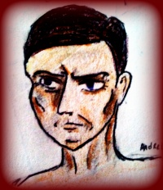
Put away past animosities,
And all would be fine.
Sith Warlord Andrelious J Inahj,
Be MY Valentine.

Slide 11
Lots of love…..
From…..
?

