Slide 1
Battle of Judecca
Retaking of the Imperial Palace
37 ABY

Slide 2
Situation
Currently, the Imperial Palace is being held by forces loyal to Fias Zhan, a former Royal Guardsman for Emperor Palpatine.

Slide 3
Mission
The objective for our mission is threefold
Reclaim the Imperial Palace
Eliminate all enemy forces
Capture or kill Fias Khan

Slide 4
Execution
We will mount an offensive against the entrenched enemy forces
Artillery barrage
Air Assault main effort
Commando teams and strike teams made up of Dark Jedi will assault as well
Aviation assets will provide transportation, medvac, and close air support

Slide 5
Scholae Order of Battle
90th Legion
4 companies of AT-XT’s
4 companies of Infantry
3 squadrons of LAAT/I’s
1 squadron of LAAT/c’s
Dark Jedi of Scholae Palatinae
Dorimad Sol
Acclivis Draco
Caliburnus
Special Operations Command
1 Engineer platoon
4 Medical platoons
12 Commando Squads
12 Sniper teams

Slide 6
Enemy Order of Battle
Fias Khan
At least a battalion of lightly armed troopers
Unknown number of traitors from Scholae Palatinae
Unknown heavy weapons
Unknown if they have activated the defense systems

Slide 7
Terrain
Urban
Palace is a heavily fortified castle
Rooms designed to provide maximum cover for defensive troops
Throne room is located in the center dome
Defensive walls make assault more difficult
Towers provide additional defensive firepower and cover
Moat provides more difficult assault environment

Slide 8
Communications
Main Communications Channels
Command
A64324.12
B47573.78
C75378.81
Aviation
A74138.53
B34024.80
C18437.24
Artillery
A87378.39
B48052.93
C94025.33

Slide 9
Medical
Medical will be handled by the medical platoons of the Imperial Scholae Guard Special Operations command
Triage points will be set up at Points X-Ray, Yankee, and Zulu

Slide 10
Indirect Fire
Preplanned Artillery Coordinates
Alpha
Bravo
Charlie
Delta
Echo
Foxtrot
Gamma

Slide 11
Landing Zones
4 Preplanned Landing Zones
Zones labeled 1-4
A company will land at each one immediately following preplanned artillery barrage while AT-XT’s storm the front gates laying down covering fire for the assault
Dark Jedi Strike teams will also land at these with 2 teams assigned to each LZ

Slide 12
Contingency Plan #1
Unable to reclaim the palace within 12 hours
If we are unable to reclaim the palace within the allowed timeframe, we will be forced to destroy the palace
12 hours is the limit due to that being the minimum amount of time it would take to crack the security encryption on the Scholae database
An auto-destruct sequence can be initiated from a number of places within the palace:
ISG offices in the basement level
Command Center in the center of the complex
Emperor’s Throne room on the top level

Slide 13
Contingency Plan #2
Emperor is rescued, but unable to reclaim entire palace.
Self-destruct will not be used
AT-XT’s and LAAT/I’s will provide enough firepower to level the uncontrolled towers and other areas of the palace

Slide 14
Contingency Plan #3
Fias Zhan is unable to be captured
If unable to capture without great risk, all available weaponry including aviation assets will fire on the suspected area of the palace where he is located

Slide 15
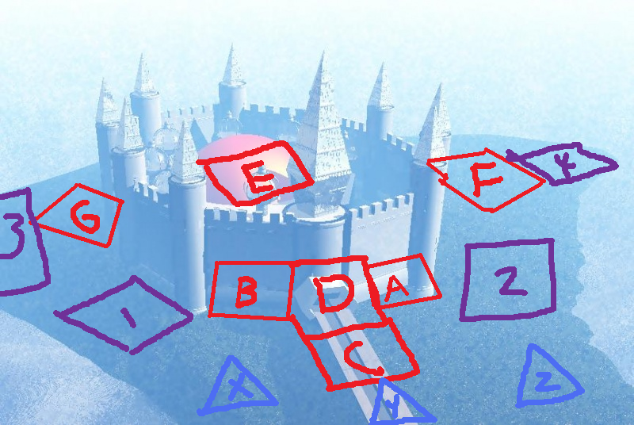
Map with Overlay
Red – Pre-Planned Artillery Strikes
Blue – Medical Triage Points
Purple - LZ

Slide 16
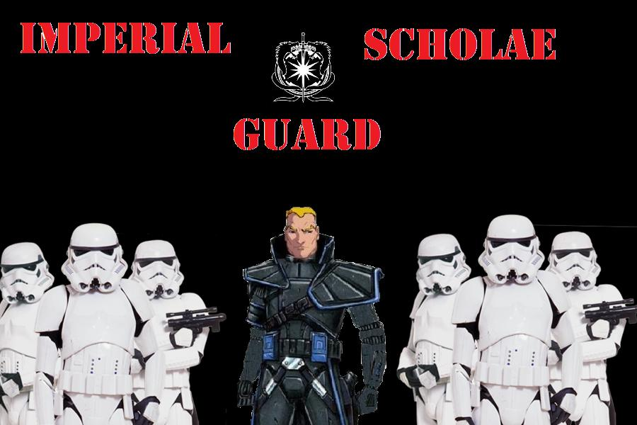
THE END
Thank you for coming to our briefing.
Have a nice Imperial Day!

