Slide 1
Warpath
The BT Leadership
(Limited Edition)

Slide 2
Participants
SR JScumm, #7764
SC Lu’aisha Gresee, #13090
SC Seridan Brehevik, #13767

Slide 3
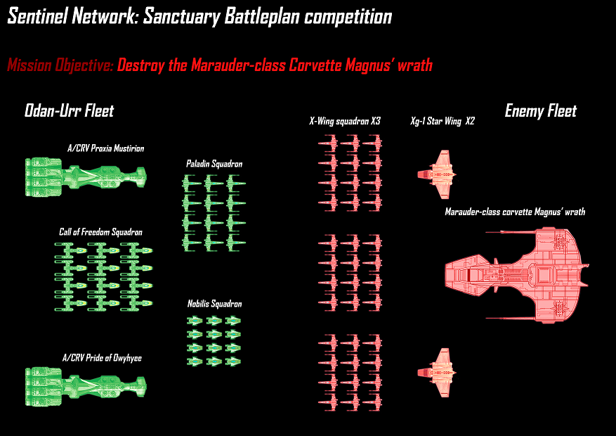
Warpath Proposal
Analysis: The primary mission is to destroy the enemy Marauder-class Corvette. If we take out the corvette, we can remove their leadership, and hopefully stop the attack in its tracks. Proposal: The most effective way to do this is with torpedo runs by the Y-wings, but the fighters will get in the way. The first thing must be to distract the enemy fighters. There are too many to destroy. If we focus on destroying the fighters, the corvette and star-wings could become more dangerous.

Slide 4
Phase 1
Purpose: To distract the fighters, in order to allow the Y-wings to perform torpedo runs on the corvette without opposition.
Action: 4 A-Wings intercept to taunt one enemy squadron while being backed up by 4 X-Wings. Remember, they do this to lure the enemy to keep the fighters away from the Marauder, not to destroy the enemy fighters.
NB: Our fighters will add more power to their engines and shields, taking power from their weaponry. This allows them to move quicker and perform and maneuver better. Their main focus is distracting the fighters, allowing for the Y-wings to flank.

Slide 5
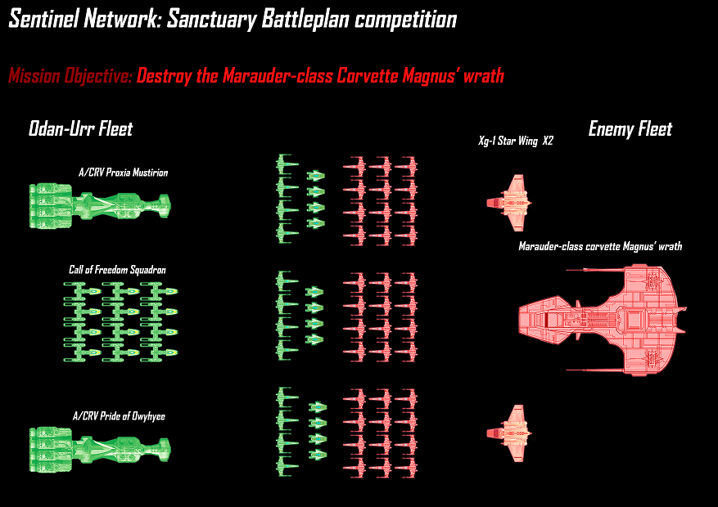
Phase 1

Slide 6
Phase 2
Purpose: The Corvettes will move in to reinforce the A-Wings and X-Wings, and will begin destroying the enemy fighters with their laser cannons, turbolasers, and missiles.
Action: Both of our Corvettes moves to the point below to back up the A-Wings & X-Wings, while two Y-Wings will advance to confront each Star Wing. These Y-Wings should be able to flank over the enemy fighters.
After the enemy fighter forces have thinned, the rest of Y-Wings will do the first torpedo run on the Marauder-class Corvette. The A-Wings and X-Wings should remember to stay away from the Marauder.

Slide 7
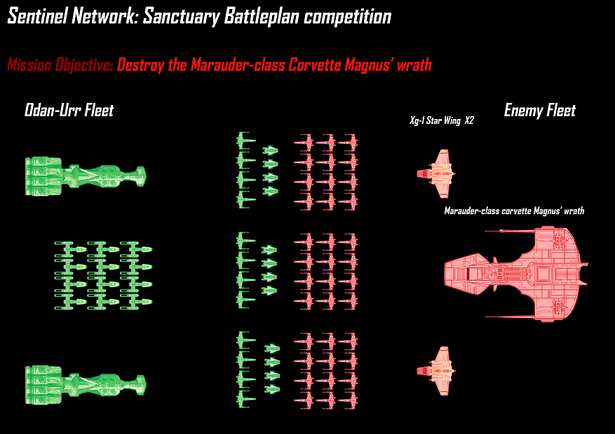
Phase 2

Slide 8
Phase 3
Purpose: As the enemy fighters continue to thin, our corvettes begin to move forward to confront the enemy corvette. Our fighters can begin to be more aggressive, giving more power to their weaponry. The A-Wings can use their concussion missiles, however the X-Wings can
Action: Here are the positions. The Assassin-class corvettes can start to move forward towards the Marauder. Remember, Corvettes are anti-fighters with their turbolasers and laser cannons. The key here is to keep enemy fighters occupied, so the Y-Wings can still slip through the enemy fighters to attack the Marauder.
The Star Wings have missiles, so the Y-Wings assigned to each one should keep them occupies, as well as away from the other fighters. The Y-Wings could use their ion cannons to paralyze the Star Wing’s circuitry.

Slide 9
Phase 3

Slide 10
Phase 4
If all goes as planned, our Corvettes have advanced, approaching the Marauder. They will be backed up by the 8 Y-Wings assigned to them. These 8 Y-Wings will be split up into three groups: two groups of 3 and one group of 2. The two groups of three Y-Wings will attack from both the starboard and port sides of the Marauder. The first targets to be torpedoed are the Missile Launchers, then the Tractor Beams, Turbolasers and the Shield Generators.
Our corvettes can use all the weaponry at their disposal to attack the Marauder. If there are other enemy ships in range, then they can also attack these.
After these vital systems have been dealt with, the last two Y-Wings, along with any unneeded X-Wings*, will do a final charge. They can either disable the Marauder with their ion cannons or destroy it with torpedoes. Just remember to stay away from the missile, tractor beam and laser range of the Marauder.
*By ‘unneeded’, I mean any X-Wings that are not needed in herding up the remaining enemy fighters.

Slide 11
Phase 4

Slide 12
Additional Notes/FAQ
- Are we sure 7 ships can distract 12? Or could some X-wings break away to pursue the y-wings?
Yes, because we're outnumbered, they will think they can defeat our fighters easily. But our fighters will do maneuvering tricks and only fire if needed. In X-Wing game, I'll adjust more power to engines (for speed) and shield than to weaponry
- Are 2 y-wings enough for a star wing?
One Y-Wing can't handle a Star Wing for sure unless the pilot is Wedge Antilles or Poe Dameron, that's why two Y-Wings will be sent, to keep the Star Wing busy.
- Y-wings could go over/under the fighters, instead of through? Flank them vertically or something?
Yes, my phase 2 picture shows the Y-Wings to attack from sides (yellow lines), which means they won't go through the enemy fighters but maybe above them so they can get a clearer view and won't get caught in enemy fires
- Can our two corvettes and the 24 A+Xwings defeat 36 Xwings?
In EaW game, Crvs are anti-fighter. If you're attacked by fighters, the right counter is a Crv. It is meant not to defeat the enemy fighters, just to keep them distracted and busy to buy time for the Y-Wing to do the torpedoes run. If we can destroy the Marauder ASAP, there won't be command for enemy fighters from their leader.
- We seem to have a few Y-wings in reserve for the final phase - could we use their ion cannons on any fighters/star wings?
Well, the primary objective is to destroy/disable the Marauder Crv ASAP. Each Y-Wing carries two torp launchers means 2 x 4 torp = 8 torpedoes so 6 Y-Wings can launch 48 torps. That’s enough to cripple the Marauder even if only 50% of their torps can hit their targets successfully. After the couple of 3 Y-Wings have done their job they can assist the A+X-Wings though I will command them to shoot their ion cannons to disable the Marauder, so the last two Y-Wings can easily destroy the Marauder with 16 torps.
- X-wings have torpedoes too - in the final phase, could we use them for a torpedo run?
Of course, if they're not busy with the enemy fighters

Slide 13
Additional thoughts/analyses and alternate strategies
https://docs.google.com/document/d/1iphc4ym8IRw7Xf0D6aT-jXDWNLHKcjP56Ynbhn4r8OA/edit?usp=sharing
This is where some analyses came from, as well as prior knowledge of the EaW game. There are also alternate strategies proposed, but were ultimately not chosen.

