Slide 1
BETWEEN LIGHT AND DARK
OPERATION CLEAN SWEEP
PARTICIPANTS
Seer Tra’an Reith di Plagia #9059
Battlelord Va’nia Drellik #4195
Warrior Dracaryis #13802
Warrior Octavia Morgan Obrie #10074
Acolyte Alishu #9947

Slide 2
MISSION AND INTENT
Situation:
Enemy forces from Clan Odan Urr have landed on Florrum and initiated the evacuation of Undesirables from the base. Enemy forces have established hasty defensive positions in the vicinity of the base. They have taken control of a geothermal power facility and an orbital defense ion cannon. Additionally, enemy sniper and scout teams have established overwatch positions in canyons along the two primary avenues of approach.
Mission:
Limit interference from Pirates.
Take Control of the Geothermal Power Station and the Planetary Defense Cannon.
Take Control of the Undesirable Base.
Prevent enemy from extracting Undesirables

Slide 3
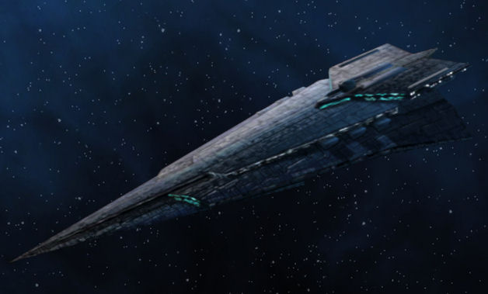
FRIENDLY FORCES
Plagueis – 1 Combined Arms Regiment
• Trandoshan Slavers - 150
• Infantry – 861
• Heavy Infantry – 369
• Scouts – 123
• Engineers – 165
• Medics – 165
• B2 Droids – 328
• SD-10 Battle Droids – 25
• Droideka – 8
• All Terrain Attack Pods – 6
• All Terrain Anti-Aircraft – 4
• All Terrain Experimental
Transports – 24
• Armored Assault Tanks – 24
• All Terrain Tactical Enforcers – 6
• Ultra Light Assault Vehicle – 7
• 74-Z Speeder Bike – 10
• AV-7 Cannons - 12
Strike Force Aurek
30 Scouts
10 SD 10’s
4 Droidekas
3 ATAP’s
3 ATTE’s
3 ULAV’s
50 Trandoshan Slavers
300 Infantry
125 heavy Infantry
55 Engineers
50 Medics
128 B2 Droids
2 ATAA’s
10 ATXT’s
4 AV 7 Cannons
2 Speeder Bikes
Weequay Interdiction Force
(Taken From SF Aurek )
1 ATAP
3 SD 10's
10 Trandoshan
60 Infantry
15 Engineers
10 Medics
50 Heavy Infantry
Strike Force Besh
3 SD10's
30 Scouts
3 Speeder Bikes
36 B2 Droids
35 Medics
35 Engineers
60 Heavy Infantry
25 Trandoshan Slavers
130 Regular Infantry
2 ATXT’s
Strike Force Cresh
2 SD10's
30 Scouts
3 Speeder Bikes
36 B2 Droids
35 Medics
35 Engineers
69 Heavy Infantry
25 Trandoshan Slavers
131 Regular Infantry
2 ATXT’s
Strike Force Dorn
33 Scouts
10 SD 10’s
4 Droidekas
3 ATAP’s
3 ATTE’s
4 ULAV’s
50 Trandoshan Slavers
300 Infantry
125 heavy Infantry
50 Engineers
45 Medics
128 B2 Droids
2 ATAA’s
10 ATXT’s
4 AV 7 Cannons
2 Speeder Bikes

Slide 4
ENEMY FORCES
Location and Allocation of Forces Unknown
Odan-Urr – 1 Joint Task Force
• 150 Wookie Beserkers
• 661 Infantry
• 330 Rangers
• 330 Scouts
• 16 Sniper Teams
• 41 Engineers
• 41 Medics
• 32 BX-Series Droids
• 32 Droidekas
• Undesirable Militia (Light Infantry) - 330
• Armored Assault Tanks -70
• Mobile Artillery – 10
• 74-Z Speeder Bike – 10

Slide 5
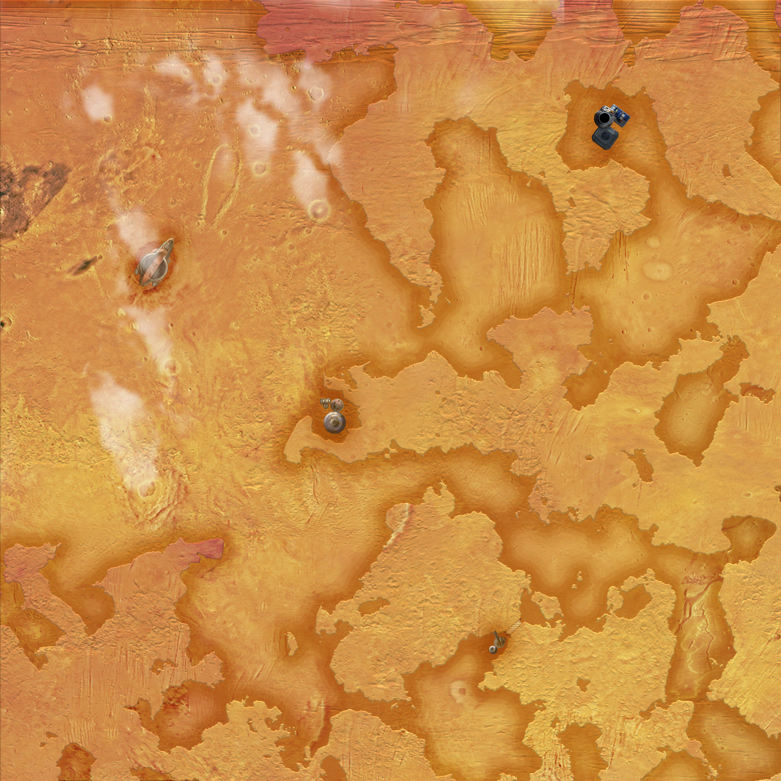
INTELLIGENCE ESTIMATE
ENEMY MISSION:
Defend Undesirable base and key infrastructure from attack by Plagueis Forces. Rapidly extract all personnel from the base.
Key Tasks:
Establish hasty defenses along all avenues of approach in order to limit Plagueis freedom of maneuver
Secure Base, Geothermal plant, and Orbital Defense Cannon
Prevent disruption of defenses by Weequay pirate network
ENEMY VULNERABILITIES
Limited force availability allows for fewer troops to secure the various sites.
Terrain plays to attacking force. Defenders limited to small engagement zones in canyons and must secure three major targets at once.
ENEMY ENDSTATE
Plagueis forces fixed in canyon, unable to continue forward advance. All Undesirable personnel extracted from base.
Eliminate Weequay Interference
Enemy Objectives – Control Points
Enemy Objective – Sniper Overwatch and Ambush
Enemy Objective – Control Zones To Allow for Extraction of Targets

Slide 6
CONCEPT OF THE OPERATION
MISSION:
Assault Enemy on Florrum and Remove Them while Achieving Objective of control of Undesirables
CONCEPT OF THE OPERATION:
PHASE I: Limit Weequay Interference and Clear Northern Approach
PHASE II: Assault Geothermal Plant With Strikes Besh and Cresh
PHASE III: Clear Southern Approach and Assault Planetary Ion Cannon
PHASE IV: Secure Undesirable Base
ENDSTATE:
Complete Control of Engagement Zone
Besh
Insertion
Weequay
Interdiction
Aurek
Insertion
Cresh
Insertion
Eliminate Weequay Interference
Control Points
Clear Assault Routes
Dorn
Insertion
Control Zones
To Allow For Assault and Extraction

