Slide 1
Aftermath Battleplan
Tra’an Reith #9059
Abadeer Taasii #14580
Maenaki Dalevi'in #13419
Celahir Erinos Arconae #6109
Lucifer Romanov #14596

Slide 2
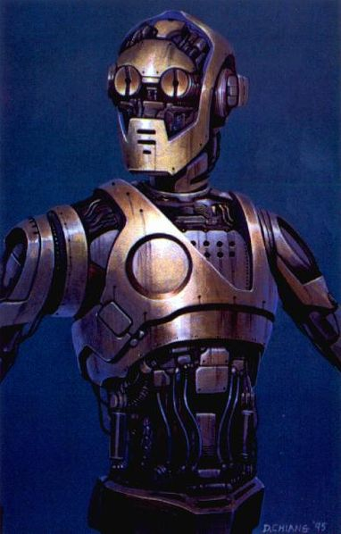
Greetings Team Alpha
Warning: This Mission is Suicide.
Mission Objectives
Land on Antei
Destroy the Iron Legion
Kill the Grand Master

Slide 3
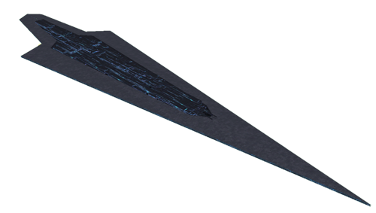
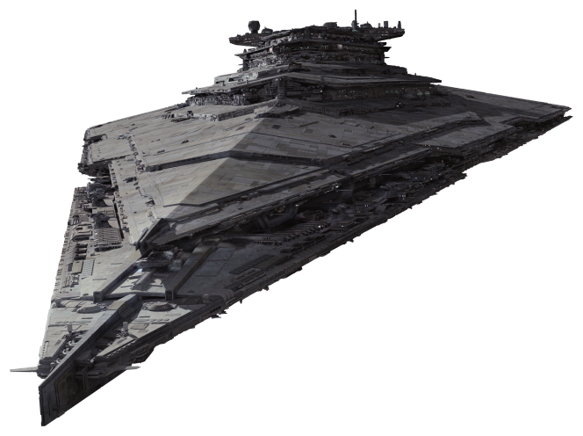
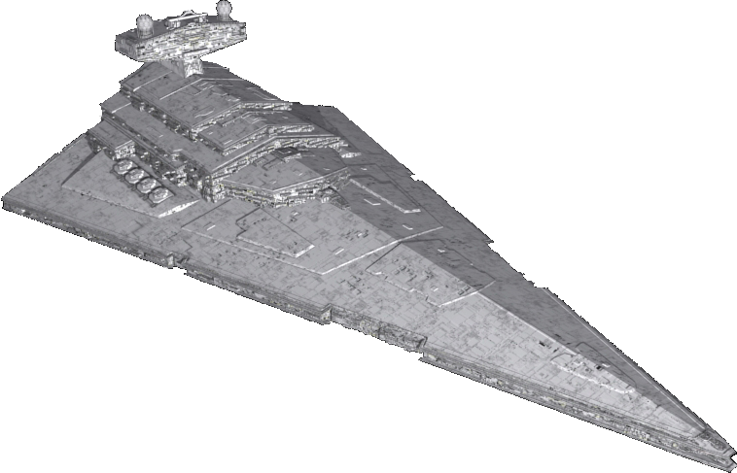
Enemy Fleets

Slide 4
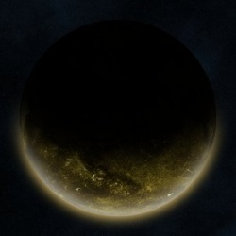
.
.

Slide 5
.

Slide 6
Army Force Vornskr
X-1 Viper Automadons
Armored Assault Tank
All Terrain Experimental Transports
AV-7 Antivehicle Cannons
All Terrain Attack Pods
All Terrain Anti-Aircraft
Ultra-Light Assault Vehicles
74-Z speeder bikes
SD-10 battle droids
Droidekas
B2 super battle droids
LAAT/i gunships
LAAT/c gunships
Drop pods
Army Force Rancor
X-1 Viper Automadons
Armored Assault Tank
All Terrain Experimental Transports
AV-7 Antivehicle Cannons
All Terrain Attack Pods
All Terrain Anti-Aircraft
Ultra-Light Assault Vehicles
74-Z speeder bikes
SD-10 battle droids
Droidekas
B2 super battle droids
LAAT/i gunships
LAAT/c gunships
Drop pods
Army Force Wampa
All Terrain Tactical Enforcers
Armoured Assault Tank
All Terrain Experimental Transports
AV-7 Antivehicle Cannons
All Terrain Attack Pods
All Terrain Anti-Aircraft
Ultra-Light Assault Vehicles
74-Z speeder bikes
SD-10 battle droids
Droidekas
B2 super battle droids
LAAT/i gunships
LAAT/c gunships
MAAT gunships

