Slide 1
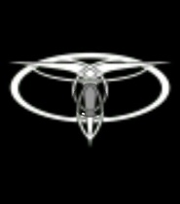
AFTERMATH OP Piercing Trident
0915 ZULU | AFTERMATH
JOINT OP COMMAND – PG. 1
Taranae Rhode (#13721)
Kul'tak Drol (#13819)
blackhawk (#14299)
Laren Uscot (#12946)
Ranarr Kul (#14229)

Slide 2
0915 ZULU | AFTERMATH
JOINT OP COMMAND – PG 2
Situation
After a series of hit-and-run attacks on allied fleets, the Armed Forces of the Iron Throne have taken up defensive positions around Antei. Their ships lay in wait around the planet, and the Grand Master’s armies have taken up heavily entrenched defensive positions on the surface. Various battalion-sized forces have occupied Codei prison, the Dark Hall, and the Hall of Immortals. There are also artillery positions located at the Triumvirate Library and Temple Tiamat. Preliminary intelligence also indicates the presence of forward reconnaisance and sniper elements, but their locations are unknown.
Mission
Break the Iron Navy blockade of Antei
Seek and destroy Iron Legion ground targets
Prevent enemy from extracting the Grand Master
Disrupt enemy communications, limiting effective artillery and orbital bombardment

Slide 3
0915 ZULU | AFTERMATH
JOINT OP COMMAND – PG 3
PLAGUEIS (PLA) Combined Arms Battalion 2x H. Armor Company 4x Armor Company 3x Rifle Company 6x AT-TE 24x AT-XT 8x AAT 8x AT-XT 16x AAT 7x ULAV Infantry Battalion 4x Rifle Company Heavy Infantry Platoon Infantry Battalion 1x Rifle Company 3x B2 Battledroid Company 8x Droideka Special Troop Battalion Recce Platoon Artillery Company Engineer Platoon Medical Company 12x AV-7 cannon 6x AT-AP 10x 74-Z Speeder Bike 4x AT-AA Communications Platoon | TARENTUM (TAR) 2nd Infantry Regiment 3x Battalions: 1x Light Infantry Battalion 1x Droid Battalion (B2s) 1x Mechanized Infantry Battalion Task Force Piranha (-) Imperial II-class Star Destroyer Magnus Kaerner (Flagship) 12x TIE Avenger Omega Squadron 12x TIE Avenger Shadow Squadron 12x TIE Defender Stingray Squadron 12x TIE Interceptor Lightning Squadron 12x Scimitar Assault Bomber Wraith Squadron 12x BTL-S8 K-Wing Infiltrator Squadron Republic-class Star Destroyer Revenge 12x TIE Avenger Aries Squadron 12x TIE Avenger Virgo Squadron 12x Y-Wing Scorpius Squadron Majestic-class Heavy Cruiser Corsair 12x E-Wing Specter Squadron 12x TIE Avenger Ghost Squadron 12x TIE Interceptor Shadow Squadron 12x Y-Wing Lich Squadron Bothan-class Assault Cruiser Doomsday 12x TIE Avenger Renegade Squadron 12x TIE Defender Sub-Zero Squadron 12x Scimitar Assault Bomber Banshee Squadron 12x BTL-S8 K-Wing Intruder Squadron Belarus-class Medium Cruiser Phlegethon Belarus-class Medium Cruiser Cocytus Belarus-class Medium Cruiser Requiem Corellian Gunship Huntsman Vanguard-class Heavy Assault Gunship Cestus Vanguard-class Heavy Assault Gunship Gladius Vanguard-class Heavy Assault Gunship Tridens | ARCONA (ARC) Reinforcements Arcona Expeditionary Force Nebula-class Star Destroyer Invicta {Flagship} The NSD Invicta Attached Starfighter Units AEF Wing I (5 Squadrons) - Wing Commander Zilghar Graviell 12 XJ X-Wing - Black Wind Squadron 12 XJ X-Wing - Lightbane Squadron 12 XJ X-Wing - Void Squadron (Non-Dark Jedi Element) 12 B-Wing - Scourge Squadron 12 E-Wing - Doto Squadron 12 StealthX Fighters - Void Squadron (Dark Jedi Element) Attached Transport Craft 18 Armored Interface Craft-4 Epsilon Transport Group (12 AIC-4s) Zeta Transport Group (6 AIC-4s) Attached Army Units (Division X) 22 Infantry Squads - 220 Troops 22 Heavy Trooper Squads - 220 Troops 3 Scout Squads - 30 Troops 3 Medic Squads - 30 Troops 5 Engineer Squads - 50 Troops 3 Droideka Squads - 6 Units 4 Special Forces Squads - 16 Troops 3 Wilderness Fighters Squads - 30 Troops Soulfire Strike Team Erinos Clan Total: 602 Troops and 6 Droidekas Bothan Assault Cruiser Darkest Night Attached Starfighter Units AEF Wing II (4 Squadrons) - Wing Commander Elan Gable 12 XJ X-Wing - Blue Mist Squadron 12 XJ X-Wing - Black Tide Squadron 12 K-Wing - Dark Sight Squadron 12 E-Wing - Lucius Squadron Nebula-class Star Destroyer Encanis Attached Starfighter Units AEF Wing IV (4 Squadrons) 12 TIE Avengers - Messiah Squadron 12 TIE Avengers - Ignition Squadron 12 B-Wings - Sunsinger Squadron 12 B-Wings - Adjudication Squadron Attached Transport Craft 12 Armored Interface Craft-4 Upsilon Transport Group (12 AIC-4) Bothan Assault Cruiser Shadow Attached Transport Craft 6 Armored Interface Craft-4 Attached Army Units (Division XII) 9 Infantry Squads - 90 Troops 9 Heavy Trooper Squads - 90 Troops 1 Scout Squads - 10 Troops 2 Medic Squads - 20 Troops 1 Engineer Squads - 10 Troops Total: 220 Troops Acclamator I-Class Assault Ship Shadehammer Agave-class Picket Valour’s Fall

Slide 4
0915 ZULU | AFTERMATH
JOINT OP COMMAND – PG 4
Enemy Composition:
Exact intelligence on enemy composition is scarce. It is estimated that the forces of the Iron Throne contain at least twenty battle-ready, cruiser-or-higher class vessels in orbit of Antei. Effective jamming capabilities have made discovering the composition of the enemy fleet impossible.
Furthermore, based on lifesign readings taken before the jamming began, we know the locations being assaulted are occupied, but not be whom or what. Thus, the scheme of maneuver is reflective of territorial objectives required to maintain control of the Battle Space. Estimated numbers of troops are at least equal to ours with the addition of possible Arconan reinforcements. Expect heavily fortified defensive positions.

Slide 5
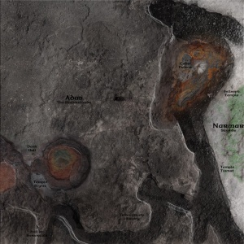
0915 ZULU | AFTERMATH
JOINT OP COMMAND – PG 5
Intelligence:
Enemy expected to be foritifed in “X” positions
Composition and layout of forces unknown. Forces will be stationary (likely).
Enemy artillery located at “

Slide 6
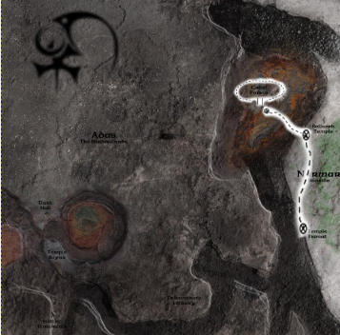
0915 ZULU | AFTERMATH
JOINT OP COMMAND – PG 6
Phase One:
Plagueis strike force establish landing zones. Landing Zone A secured for artillery and Tarentum landing forces. Landing Zone B secured.
Attack launched from Landing Zone B to retake the Eastern Temples situated on high ground.
Suppressing fire from AV-7 cannons established at Landing Zone A.
A
B

Slide 7
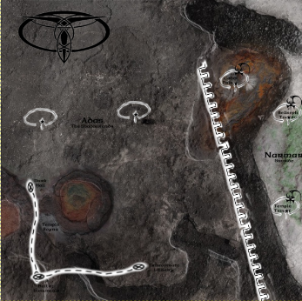
0915 ZULU | AFTERMATH
JOINT OP COMMAND – PG 77
Phase Two:
Tarenti forces land at A, begin direct assault on Southern positions. Remaining Plagueian forces follow, forming Eastern flank, Tarenti on the West.
Landing Zone B is moved, Firebase C established to the East. Provides supporting fire for the final assault to the West.
Arconan Forces land (if possible) at Firebase C, advance on Triumvirate Library from the East, heading West.
A
C

