Slide 1

Alliance High Command
1130 hours Zulu
Rogue One: A Star Wars Story
Operation Kilo-One-Zero
Privateer Laren Uscot, #12946

Slide 2
Alliance High Command
1130 hours Zulu
Mission & Intent
Rogue One: A Star Wars Story
I. Situation
The Galactic Empire has located Echo Base on the planet of Hoth in the Anoat System. By order of Alliance High Command, a planet-wide evacuation has been ordered. However, the Imperial Fleet and their ground forces will land prior to the completion of the evacuation. The expected landing zones are out of initial reach of major base infrastructure, though it will be within range of Alliance defensive positions. Alliance intelligence expects an overwhelming Imperial force to land on the surface of Hoth and attack Echo Base. Intelligence also suggests that Lord Vader is among the incoming Imperial forces.
Mission Summary
Conduct a successful tactical retreat of Echo Base.
Delay Imperial forces attempting to delay the evacuation of Echo Base.
Protect the 1) Shield Generator and 2) Ion Cannon for as long as possible.
Destroy any and all Alliance equipment/intelligence remaining in Echo Base.

Slide 3
Alliance High Command
1130 hours Zulu
Intelligence Estimate
Rogue One: A Star Wars Story
Enemy Forces (Estimated)
Enemy Capabilities
Blizzard Force
  5+ AT-ATs
  10+ AT-STs
  2+ HAVw A6 Juggernauts
  Estimated 1000-3000 Stormtroopers
    Unknown number of Elite Cold Weather Assault Stormtroopers
501st Legion (-)
  Estimated 1000-3000 Stormtroopers
Imperial Starfleet
  Executor-Class Star Dreadnaught “Executor”
  Estimated 3-6 Imperial-Class Star Destroyers
  Unknown complement, TIE/LN Starfighters/TIE Bombers
Imperial forces will likely outnumber our ground forces by an estimated factor of 2:1. Fighting a battle on tough terrain against a well entrenched Alliance position will require the Empire to resort to swarm tactics, even with availability of elite units and top tier equipment. It is likely they realize there is only one possible landing zone for their troops, thus speed and strength will be necessary.
Imperial forces will likely employ a multitude of heavy armour and supporting troops to lead the assault. They have the capability and intent to overwhelm our defensive positions, and the intent to destroy our Shield Generator and Ion Cannon emplacement as soon as possible.
Finally, Imperial Stormtroopers will likely be outfitted and trained to fight in cold weather conditions. Expect fierce resistance from the advancing ground troops.

Slide 4
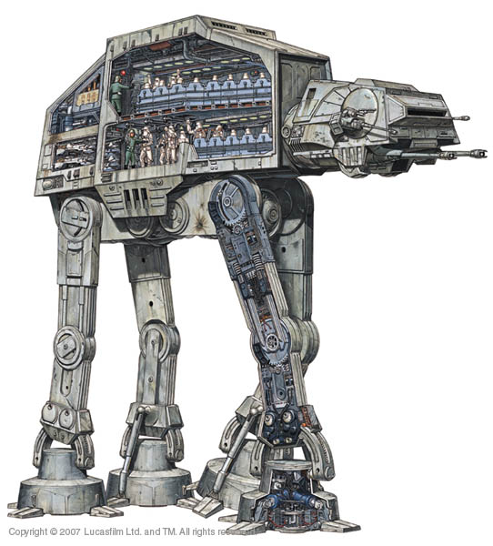
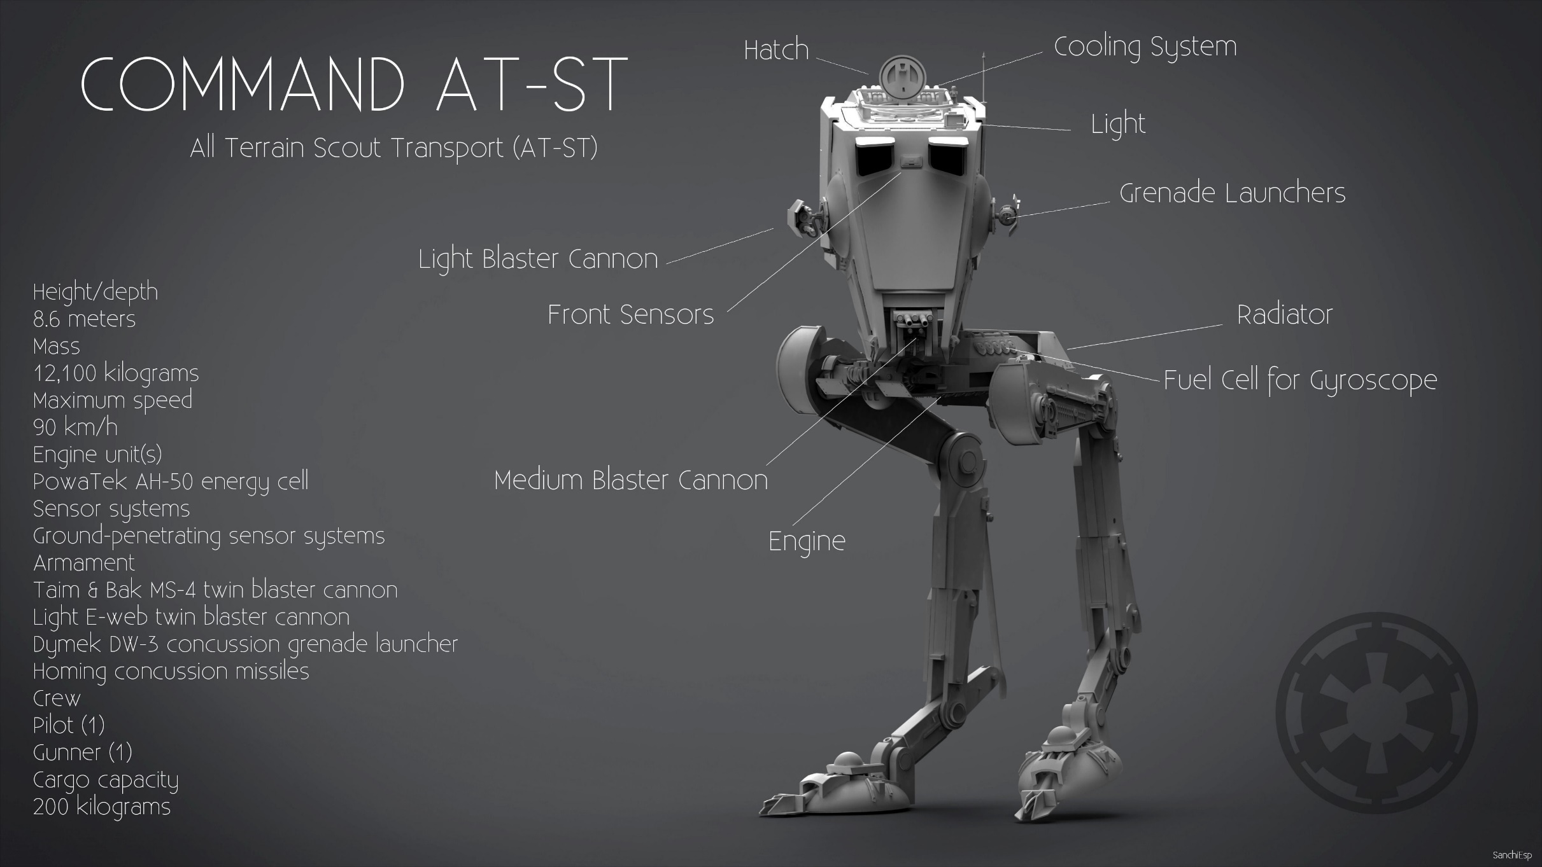
Alliance High Command
1130 hours Zulu
Intelligence Estimate
Rogue One: A Star Wars Story
AT-AT
AT-ST
This massive vehicle will most likely lead the Imperial assault.
This is an example of frontline Imperial armour. Faster than it’s larger counterpart.

Slide 5
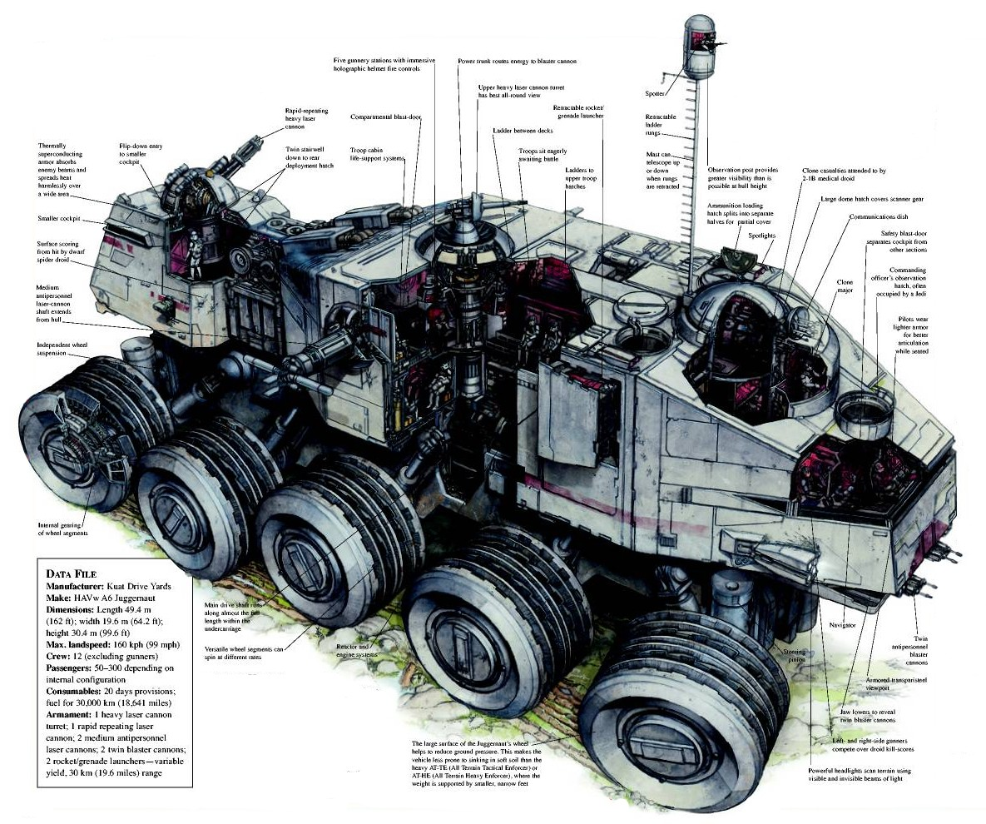

Alliance High Command
1130 hours Zulu
Intelligence Estimate
Rogue One: A Star Wars Story
HAVw A6 Juggernaut
Snowtroopers
This massive tank will likely be seen on the battlefield. More mobile than its walker counterparts, and heavily armoured.
Intelligence indicates this is the typical aesthetic and armament of “Snowtroopers”

Slide 6
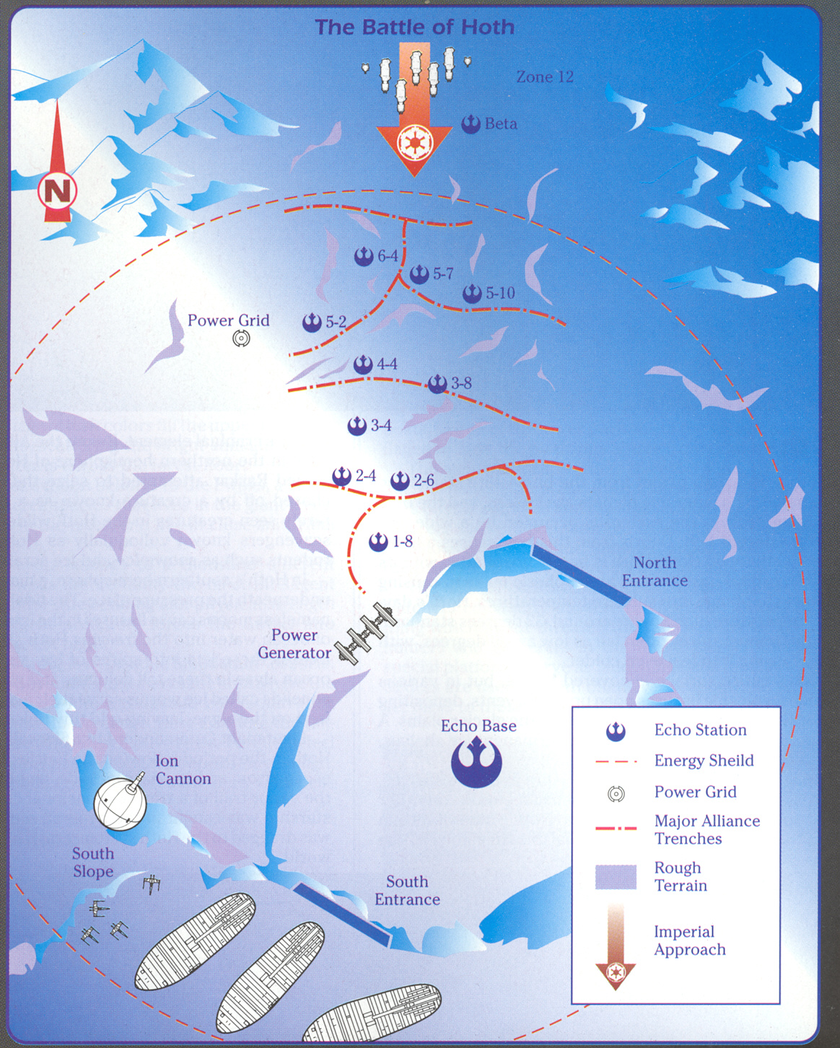
Alliance High Command
1130 hours Zulu
Intelligence Estimate
Rogue One: A Star Wars Story
Enemy Mission: Establish and secure landing zone outside of planetary shield. Seek and destroy rebel forces in order to capture/destroy Echo Base.
Important Tasks:
Destroy Alliance shield generator to facilitate orbital and artillery bombardments, landing craft..
Establish control points with which to shift axis of battle.
Destroy Alliance Ion Cannon to protect Imperial starships above Hoth.
Destroy Alliance transports attempting to escape.
Enemy Vulnerabilities
Once the enemy enters the energy shield, brief moment to focus fire on heavy armour.
Enemy targets should force enemy scheme of maneuver directly into entrenched positions. Air superiority and flank maneuvers can be utilized to engage enemy ground forces.
Enemy Endstate:
Alliance forces destroyed and unable to facilitate effective retreat. Echo Base is captured.
  - Enemy control points to shift axis of fire.
L

Slide 7
Alliance High Command
1130 hours Zulu
Rogue One: A Star Wars Story
Friendly Forces
Intent & Considerations
  Alliance Army
    5th Brigade
      10th Alliance Infantry Regiment
        2000 Alliance troopers
        20 DF.9 Turrets (Alliance Engineering Corps)
        14 1.4 FD P-Tower Laser Cannons (Alliance Artillery Corps)
      61st Mobile Infantry Battallion
        700 Alliance Elite troopers
  Alliance Fleet
    Corona Squadron – 9 T-47 Airspeeders
    Rogue Squadron – 9 T-47 Airspeeders
    Remainder of Alliance Fleet forces engaged in non-combative evacuation only. This includes T-65B X-Wings, 30 GR-75 transports, and BTL Y-Wing Starfighter Bombers.
The Commander’s intent is clear: to complete the evacuation as quickly and efficiently as possible, minimizing loss of life and resources.
Imperial forces have superior firepower, manpower, and resources. However, as long as the Energy Shield and Ion Cannon remain operational, our transports have the best chance of escape.
Due to superior terrain, the one advantage friendly forces have is terrain. There is only one direction Imperial forces can effectively attack from, and all defensive positions reflect this.
Once the final evacuation order is given, it is imperative you rendezvous at your designated launch points to get off world.

Slide 8

Alliance High Command
1130 hours Zulu
Operational Breakdown
Rogue One: A Star Wars Story
L
Mission: Defeat, repel, or delay Imperial invasion force to facilitate a full retreat of Echo Base.
Concept of Operation:
Phase 1: Once Imperial forces enter the energy shield, overwhelm heavy armour with air and turret support.
Phase 2: Limit movement of enemy infantry with effective fire support.
Phase 3: Perform hasty retreats when Imperial forces overtake major Alliance trench lines.
Phase 4: Once the final evacuation order is given, perform a hasty or tactical retreat to designated extraction points.
Key Points:
Protect the Power Generator at all costs.
Primary objective is to DEFEND retreat at all costs. If necessary, extraction is secondary.
Utilize T-47 Airspeeders to disrupt enemy armour advances.
Endstate:
Alliance forces successfully extracted from Echo Base with minimal to moderate casualties.
Primary Extraction Route
| | |
Secondary Extraction Route

Slide 9
References
Map utilized in this submission can be found here: http://tidesofwargaming.blogspot.ca/2014/11/star-wars-battle-of-hoth-galactic-civil.html
All images in this submissions are MOST DEFINITELY NOT my property. Taken from various locations on the internet.

