Slide 1
INQUISITION DOSSIER
10278-4182-1653
Subject: ANDRELIOUS MIMOSA-INAHJ

Slide 2
PERSONAL DETAILS
FULL NAME: Andrelious Jongstram Mimosa-Inahj
SPECIES: Human
GENDER: Male
AGE: Estimated early 40s
HOMEWORLD: Dantooine
MARITAL STATUS: Married
CHILDREN: 3

Slide 3
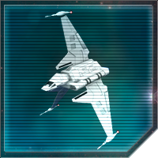
CURRENT STATUS
The last confirmed sighting of Mimosa-Inahj was during the Justicar’s attack on the former Taldryan homeworld of Karufr. Along with his wife, their children and a few other members of the rogue Clan, Andrelious escaped aboard a stolen Iron Navy vessel, designated IL-ES-GLX 4. That ship, and those aboard, have not been seen since the remnants of Taldryan successfully evaded the Justicar’s fleet.
The stolen JV-7 Shuttle looked like this. This is a stock image – we have no image of the stolen ship.

Slide 4
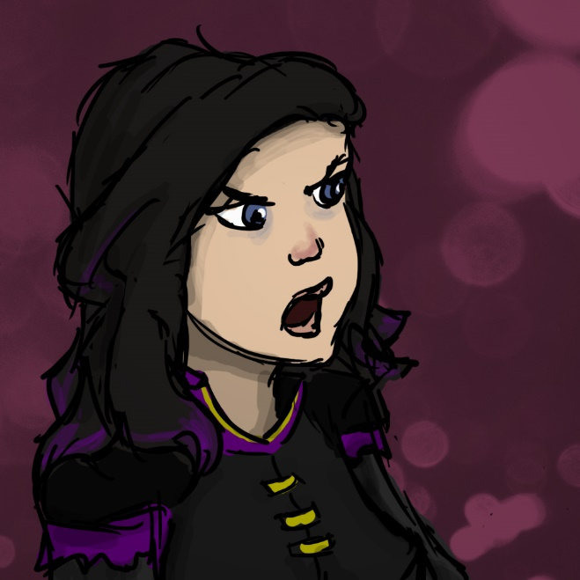
RELATIONSHIPS
It is now incredibly rare for Andrelious to be seen without his wife, Kookimarissia (see separate dossier).
From what has been observed, Kookimarissia is most definitely in charge of the marriage. In fact, Andrelious is quite simply terrified of Kookimarissia.

Slide 5
RELATIONSHIPS (CONT’D)
Andrelious has three daughters. The eldest daughter is known as Saskia Ortega-Inahj, but our records do not extend to the identity of her mother. Saskia is old enough to have previously served as part of Clan Taldryan, but her current location is unknown (see separate dossier).
Andrelious and Kookimarissia’s twin daughters, known as Poppeliamarissia and Etholimarissia Mimosa-Inahj, are toddlers. They are probably still living with their parents.

Slide 6
RELATIONSHIPS (CONT’D)
Andrelious’ parents are believed to still be alive. His father is Parck Inahj, who owns and operates a small shipping company called Inahj Intergalactic.
His mother is Licon Inahj (neé Stendec), and appears to have retired from any kind of active work.
We are aware that Licon is apparently Force sensitive, but we have no further information other than that the Inahj couple currently live on Corellia.

Slide 7
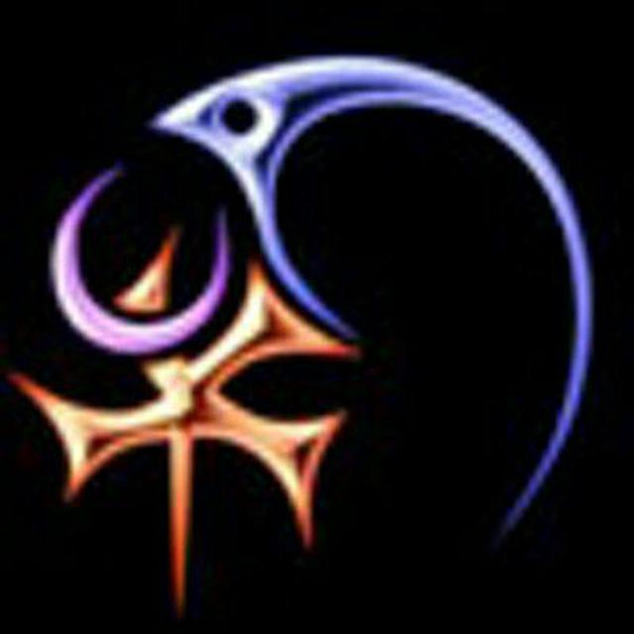
AFFILIATIONS
Mimosa-Inahj has been serving with Clan Taldryan for some time now. Prior to the attack on Karufr, he was quite happy to perform missions for us, so long as they did not involve attacking other members of his Clan.
However, he must now be considered extremely hostile.
Former affiliations include Clan Arcona, to which he is again now hostile, and an Imperial Remnant faction.

Slide 8
SKILLS
Mimosa-Inahj brought a lot to our table before he turned against us.
He is an ace starfighter pilot, a crack shot with a blaster, especially his favoured E-11 model, and is also a keen saberist. Additionally, he possesses a strong connection to the dark side of the Force, and is particularly talented with Force lightning.
This man is incredibly dangerous! Do not engage without clearance from your field commander!

Slide 9
TAKEDOWN PLAN
It has not been easy to find a weakness to exploit for this target.
The best way to get to Andrelious would be through his wife, Kookimarissia. However, she is even more hostile to our plans than Andrelious. Therefore, the only way to take Andrelious down may be to attempt to eliminate Kookimarissia.
Kidnapping the twins is not advised. Doing this would likely place agents in unnecessary danger. It is also not advised to kidnap Saskia, who is dangerous on her own even without her father’s support.
If you encounter Andrelious, speak to your field commander! He is not invincible, but taking him on unprepared could be deadly!

