Slide 1
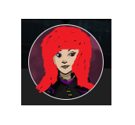
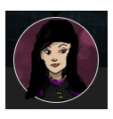
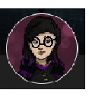
Unklicko, Krata
Unknown Persons #0-99
Unknown Persons #100-199
Unknown Persons… #102
Brief Description:
Female
Average Height
Slender build
Purple lightsaber
Seems to be one of many- Siblings maybe?
Various hair colours
Brief Synopsis:
This female has been in multiple locations. She seems to have many siblings and many sightings have been reported. They are all confident at using a purple lightsaber. She tends to be very feisty and defensive.
Possible siblings and sightings?
Cantina, Karufr ruins, 1 year ago
Chyron, Kagu Shi Factory, a few months ago
Coruscant, Library, a few months ago
Action Plan
Capture one of the siblings and interrogate to get information on her many sisters and their plan.
DO NOT KILL!!!
Corellia, Marketplace, a few weeks ago

