Slide 1
A long time ago in a galaxy far, far away. . . .

Slide 3
Episode XIV
The Great War between the Brotherhood and Collective continues.
The Collective has finally arrived in full-force on the Brotherhood's doorstep.
A full-scale battle quickly erupts high above the planet’s surface, below its powerful shield gate.
Hard-pressed, the Brotherhood summons its Clans to beat back this assault.
An armada of Clan warships arrives in the system, charging into the Collective fleet.
Their actions will help determine the fate of the Brotherhood and the galaxy . . .

Slide 4
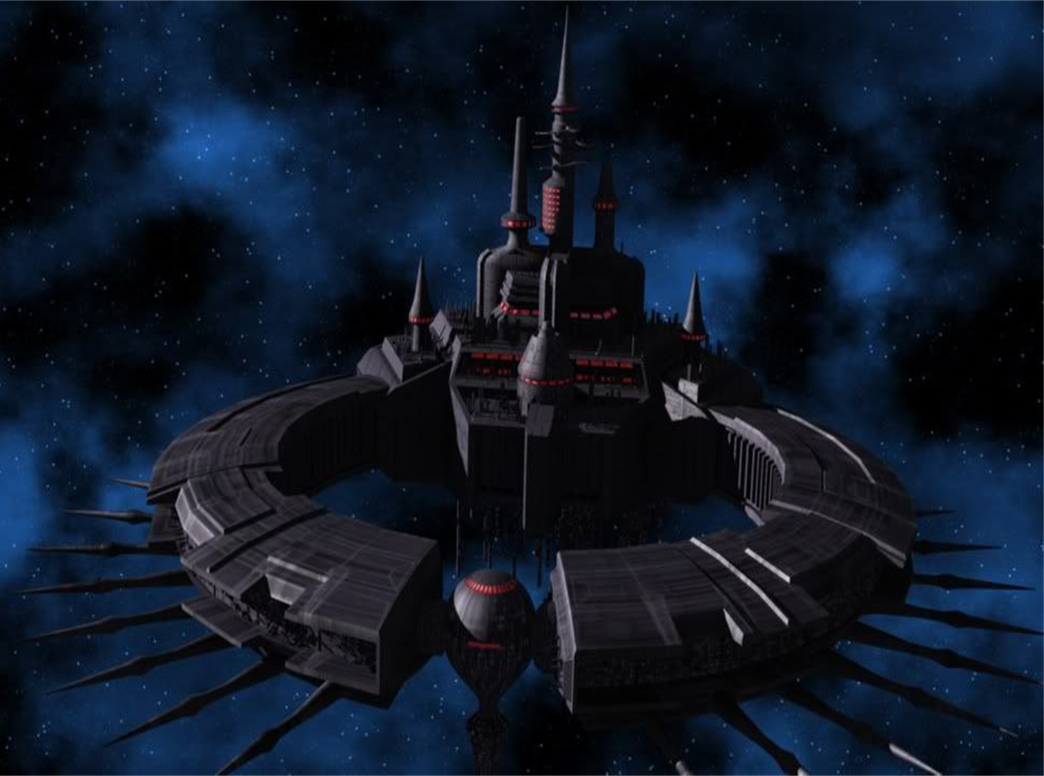
Mission: Evacuate personnel and artifacts from the platform. Prepare Administrative and Observation section for emergency return to the surface Academy on Arx itself."
Nesolat Platform
Shadow Academy
Arx system

Slide 5
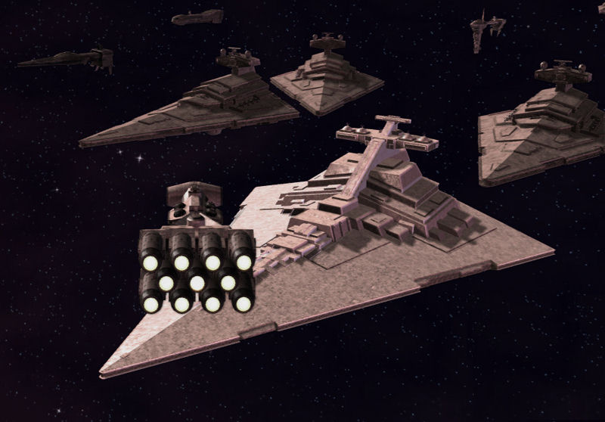
Brotherhood forces arrived in the Arx system.

Slide 6
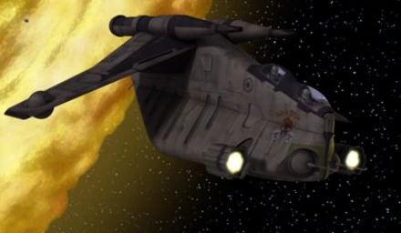
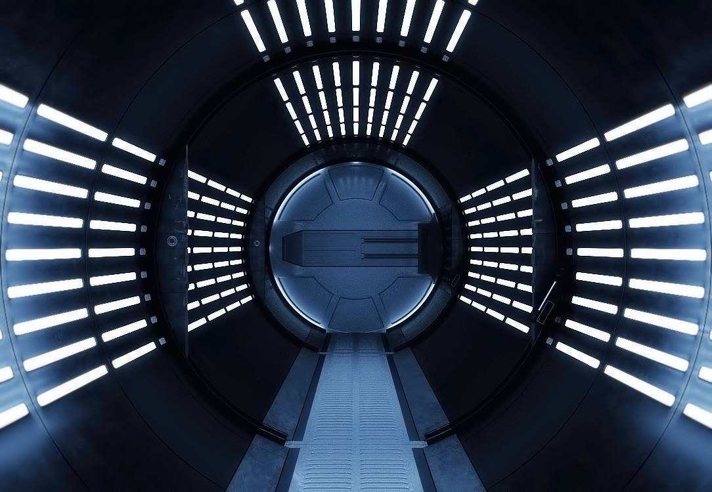
Clan Odan-Urr use LAAT transports to get to Neosat platform.
Every transporter has a specific target docking bay, to get all troops inside the platform.
The decisive battle is just beginning. . .

Slide 7
Links
https://www.darkjedibrotherhood.com/news/djb-news-great-jedi-war-xiv-homefront-begins
https://upload.wikimedia.org/wikipedia/en/0/0c/Opening_crawl.jpg
https://wiki.darkjedibrotherhood.com/images/4/42/NesolatPlatform.jpg
https://wiki.darkjedibrotherhood.com/view/File:Navyironthrone.jpg
https://starwars.fandom.com/wiki/Space_gunship?file=Low_Altitude_Assault_Transportspace_gunship-CR.jpg
https://www.youtube.com/watch?v=tGsKzZtRwxw

