Slide 1
GJW XIV: Homefront Battle Plan
OPERATION SALT SHAKER
PARTICIPANTS
Eminent Kalan Amak: 13802
Augur Farrin Xies Tarentae: 10013
Warlord Rulvak Qurroc: 14025

Slide 2
MISSION AND INTENT (PRIMARY OBJECTIVE)
Situation:
The Collective has committed the entirety of Battle Group Elysium (BG-E) in an assault on the Shadow Academy station Nesolat.
BG-E Forces are decisively engaged. It is expected that the enemy fleet will act aggressively, never backing down with little regard for their own lives, so their likely course of action is to remain engaged unless destroyed or your own retreat. Additional elements of the enemy fleet are also in orbit but are not expected to reinforce the position due to additional engagements by Brotherhood forces inside the window of this specific engagement.
Mission:
Engage Collective Forces attacking the Nesolat Platform
Establish Defensive Perimeter around the Nesolat Platform
On Order, Board and eliminate hostiles located on the Nesolat Platform

Slide 3
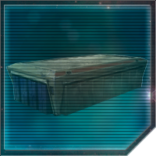
FRIENDLY FORCES (PRIMARY OBJECTIVE)
Y-85 Titan Dropship Flight
Atmospheric Assault Lander Flight
Sentinel-class Landing Craft Flight
Sentinel-class Landing Craft Flight
Sentinel-class Landing Craft Flight
1st Legion
All Terrain MegaCaliber Six (AT-M6) Artillery Line
First Order AT-AT Platoon
Kom'rk-class Fighter Flight
Kom'rk-class Fighter Flight
Raider II-class Corvette
Raider II-class Corvette
Raider II-class Corvette
Immobilizer 418-class Heavy Cruiser (containing one squadron of TIE/SA Bombers and one squadron of TIE/SF fighters)
STRIKE
GROUP 1
Y-85 Titan Dropship Flight
Atmospheric Assault Lander Flight
Sentinel-class Landing Craft Flight
Sentinel-class Landing Craft Flight
Sentinel-class Landing Craft Flight
2nd Legion
All Terrain MegaCaliber Six (AT-M6) Artillery Line
First Order AT-AT Platoon
Kom'rk-class Fighter Flight
Kom'rk-class Fighter Flight
Raider II-class Corvette
Raider II-class Corvette
Raider II-class Corvette
Immobilizer 418-class Heavy Cruiser (containing one squadron of TIE/SA Bombers and one squadron of TIE/SF fighters)
VIZSLA FLEET
STRIKE
GROUP 2
Y-85 Titan Dropship Flight
Atmospheric Assault Lander Flight
Sentinel-class Landing Craft Flight
Sentinel-class Landing Craft Flight
Sentinel-class Landing Craft Flight
3rd Legion
All Terrain MegaCaliber Six (AT-M6) Artillery Line
First Order AT-AT Platoon
Kom'rk-class Fighter Flight
Kom'rk-class Fighter Flight
Raider II-class Corvette
Raider II-class Corvette
Raider II-class Corvette
Immobilizer 418-class Heavy Cruiser (containing one squadron of TIE/SA Bombers and one squadron of TIE/SF fighters)
STRIKE
GROUP 3

Slide 4
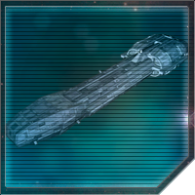
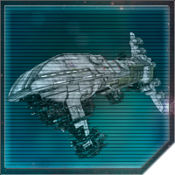
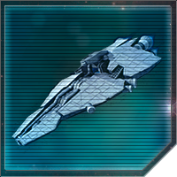
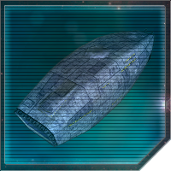
ENEMY FORCES (PRIMARY OBJECTIVE)
Tashota, Edam, Aylmer, Zeballos
(Lancer-class Collective s20 Frigate)
28 quad laser turrets
Lansford, Pencron, Calgen, Almiston, Bastra, Vassic
(Dreadnaught-class Collective a70 Heavy Cruiser)
20 heavy dual turbolaser turrets
20 heavy dual turbolaser cannons
4 warhead launchers
Yorcot, Obarel, Korpil, Straden
(Strike-class Collective m50 Medium Cruiser)
30 dual turbolaser turrets 10 ion turrets 10 tractor beams
2 squadrons of starfighters
BATTLEGROUP ELYSIUM
Z-95 Headhunter Squadron x4
T-70 X-wing Starfighter Squadron x4
Cloridorme
(Ton-Falk-class Escort Carrier)
10 dual laser turrets
1 missile launcher
6 squadrons of starfighters
Z-95 Headhunter Squadron x2
T-70 X-wing Starfighter Squadron x4

Slide 5
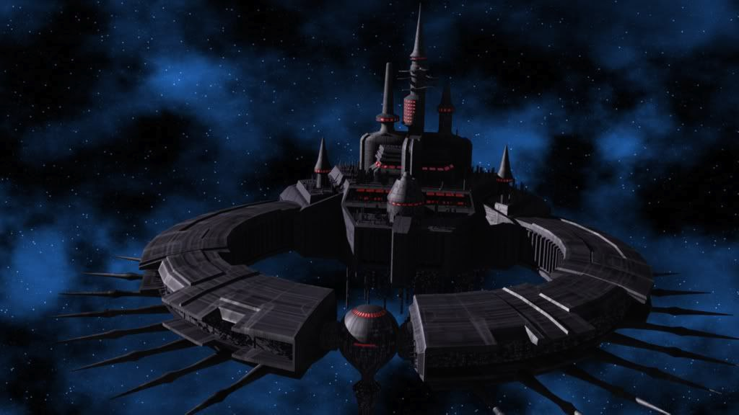
INTELLIGENCE ESTIMATE (PRIMARY OBJECTIVE)
ENEMY MISSION:
Key Tasks: Eliminate Brotherhood presence on the Nesolat platform and uncover the Brotherhood’s darkest secrets.
ENEMY VULNERABILITIES
Limited Fighter Squadrons
Hardened target
Lack of anti-interdiction capability
ENEMY ENDSTATE
Nesolat Station destroyed or knocked out of commission, and all secrets revealed.
Nesolat
x8
x8

Slide 6
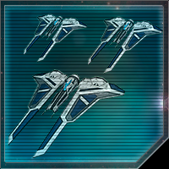
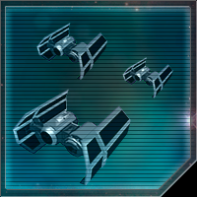
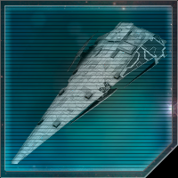
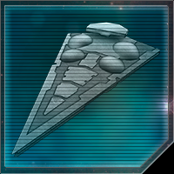
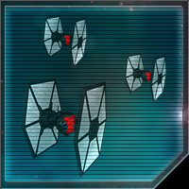
CONCEPT OF THE OPERATION (PRIMARY OBJECTIVE)
MISSION:
Prevent destruction of Nesolat platform
Destroy BG-E forces in zone
Establish defensive zone of control around the Nesolat
CONCEPT OF THE OPERATION:
For the purposes of this operation, the space combat forces of each of the three Vizslan Strike Groups (each: two flights of Kom’rk-class fighters, three Raider-II class corvettes, and one Immobilizer 418-class heavy cruiser with its two fighter squadrons) will be operating independently from their ground combat-focused peers. For clarity, they will henceforth be referred to as Fleets A, B, and C.
Simultaneously, each of the three Fleets will drop out of hyperspace at their designated attack vectors and will press in. The Raider-II class corvettes and the Kom’rk-class fighters will be deployed in an anti-space fighter role, while the two squadrons from each Immobilizer - a TIE/SA Bomber and a TIE/SF Fighter squadron - as well as the Immobilizers themselves, will focus on the capital ships. These attacks will be coordinated with the Nesolat itself so that the platform’s defenses can also assist with destruction of the capital ships.
ENDSTATE:
At endstate, Clan Vizsla has secured the defenses of the Nesolat, and have inflicted the heaviest casualties possible on BG-E forces.
Nesolat
x8
Fleet A
x6
x4
x4
x8
Fleet B
Battle Group Elysium
Fleet C

Slide 7
ENDSTATE (PRIMARY OBJECTIVE)
MISSION:
Prevent destruction of Nesolat platform
Destroy BG-E forces in zone
Establish defensive zone of control around the Nesolat
CONCEPT OF THE OPERATION:
For the purposes of this operation, the space combat forces of each of the three Vizslan Strike Groups (each: two flights of Kom’rk-class fighters, three Raider-II class corvettes, and one Immobilizer 418-class heavy cruiser with its two fighter squadrons) will be operating independently from their ground combat-focused peers. For clarity, they will henceforth be referred to as Fleets A, B, and C.
Simultaneously, each of the three Fleets will drop out of hyperspace at their designated attack vectors and will press in. The Raider-II class corvettes and the Kom’rk-class fighters will be deployed in an anti-space fighter role, while the two squadrons from each Immobilizer - a TIE/SA Bomber and a TIE/SF Fighter squadron - as well as the Immobilizers themselves, will focus on the capital ships. These attacks will be coordinated with the Nesolat itself so that the platform’s defenses can also assist with destruction of the capital ships.
ENDSTATE:
At endstate, Clan Vizsla has secured the defenses of the Nesolat, and have inflicted the heaviest casualties possible on BG-E forces.
Nesolat
x8
Fleet A
x6
x4
x4
x8
Fleet B
Battle Group Elysium
Fleet C

Slide 8
MISSION AND INTENT (SECONDARY OBJECTIVE)
Situation:
Numerous squadrons of Collective fighters - as well as eight frigates - are operating in-atmosphere above the Iron Legion Headquarters on Arx. Additional elements of the enemy fleet are also in the area but are not expected to reinforce the position due to additional engagements by Brotherhood forces inside the window of this specific engagement.
Mission:
Engage Collective Forces operating above the Iron Legion Headquarters
Establish Defensive Perimeter in and around the Iron Legion HQ
Establish air superiority in sector

Slide 9
FRIENDLY FORCES (SECONDARY OBJECTIVE)
Y-85 Titan Dropship Flight
Atmospheric Assault Lander Flight
Sentinel-class Landing Craft Flight
Sentinel-class Landing Craft Flight
Sentinel-class Landing Craft Flight
1st Legion
All Terrain MegaCaliber Six (AT-M6) Artillery Line
First Order AT-AT Platoon
Kom'rk-class Fighter Flight
Kom'rk-class Fighter Flight
Raider II-class Corvette
Raider II-class Corvette
Raider II-class Corvette
Immobilizer 418-class Heavy Cruiser (containing one squadron of TIE/SA Bombers and one squadron of TIE/SF fighters)
STRIKE
GROUP 1
Y-85 Titan Dropship Flight
Atmospheric Assault Lander Flight
Sentinel-class Landing Craft Flight
Sentinel-class Landing Craft Flight
Sentinel-class Landing Craft Flight
2nd Legion
All Terrain MegaCaliber Six (AT-M6) Artillery Line
First Order AT-AT Platoon
Kom'rk-class Fighter Flight
Kom'rk-class Fighter Flight
Raider II-class Corvette
Raider II-class Corvette
Raider II-class Corvette
Immobilizer 418-class Heavy Cruiser (containing one squadron of TIE/SA Bombers and one squadron of TIE/SF fighters)
VIZSLA FLEET
STRIKE
GROUP 2
Y-85 Titan Dropship Flight
Atmospheric Assault Lander Flight
Sentinel-class Landing Craft Flight
Sentinel-class Landing Craft Flight
Sentinel-class Landing Craft Flight
3rd Legion
All Terrain MegaCaliber Six (AT-M6) Artillery Line
First Order AT-AT Platoon
Kom'rk-class Fighter Flight
Kom'rk-class Fighter Flight
Raider II-class Corvette
Raider II-class Corvette
Raider II-class Corvette
Immobilizer 418-class Heavy Cruiser (containing one squadron of TIE/SA Bombers and one squadron of TIE/SF fighters)
STRIKE
GROUP 3

Slide 10
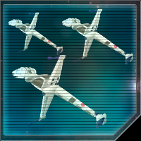
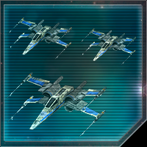
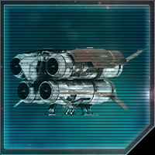
ENEMY FORCES (SECONDARY OBJECTIVE)
Eight Unknown Ships
(Lancer-class Collective s20 Frigate)
28 quad laser turrets
A/SF-01 B-Wing Starfighter Squadrons x8
ENEMY ASSAULT GROUP
Z-95 Headhunter Squadrons x16
T-70 X-Wing Starfighter Squadron x8
Collective Quadrijet Bomber Squadron x4

Slide 11
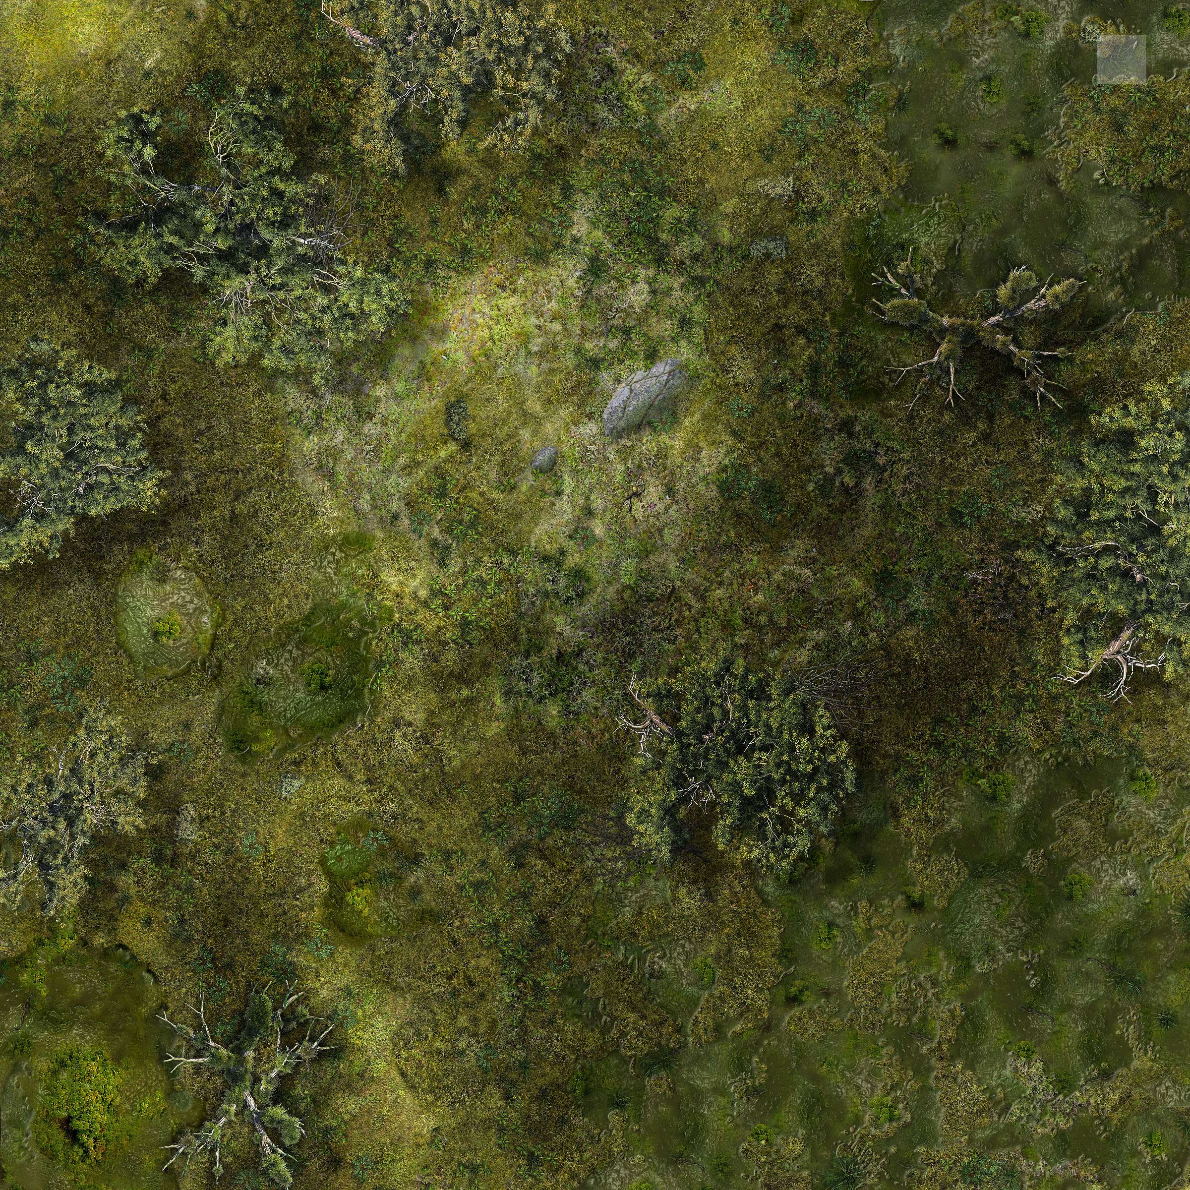
INTELLIGENCE ESTIMATE (SECONDARY OBJECTIVE)
ENEMY MISSION:
Assault and capture the Iron Legion Headquarters on Arx.
ENEMY VULNERABILITIES
Only Collective forces in the area are aerial combatants; no ground forces are currently present.
Terrain is disadvantageous to attack, as the Iron Legion headquarters is in a mountainous and forested area; this allows for concealment.
ENEMY ENDSTATE
Iron Legion Headquarters is destroyed or decommissioned, allowing for further invasion of Arx.
Main Iron Legion HQ
Area of Collective Attack

Slide 12
CONCEPT OF THE OPERATION (SECONDARY OBJECTIVE)
MISSION:
Establish a defensive perimeter around Iron Legion Headquarters and achieve air superiority.
CONCEPT OF THE OPERATION:
PHASE I: Land ground elements of the 1st, 2nd, and 3rd Strike Groups at Landing Zones A, B, and C, respectively. Air elements of each Strike Group will provide cover during the insertion.
PHASE II: Ground units will establish a defensive posture surrounding the HQ, with AT-AT and AT MegaCaliber Six walkers spread evenly along perimeter to provide surface-to-air support.
PHASE III: In coordination with ground support from the walkers, establish air superiority within the engagement zone with Kom’rk-class fighters, Raider II-class corvettes, and TIE/SF starfighters; the TIE/SA bombers will focus primarily on the enemy frigates.
ENDSTATE:
Complete control of Engagement Zone
1st Strike Group; LZ A
Main Iron Legion HQ
2nd Strike Group; LZ B
3rd Strike Group; LZ C
Area of Collective Attack

