Slide 1
Force Projection Plan: Evant-Horizon
Compiled by:
Tali Sroka
Age: 28 CY
House: Qel-Droma
Rank: Equite III
Tybalt Ma'jahirr Rawioni
Age: 19 CY
House: Galeres
Rank: Equite III
Aru Law
Age: 27 CY
House: Qel-Droma
Rank: Journeyman IV
Diyrian Grivna
Age: 27 CY
House: Galeres
Rank: Equite 3
Clan Arcona

Slide 2
Collective
Starship Analysis
Arcona
Starfighter Analysis
Battle Plan:
Ground Battle
Collective Starfighter Analysis
Battle Plan: Space Battle
Index
Arcona
Starship Analysis
Arcona Ground
Force Analysis
Operation Kill Mav

Slide 3
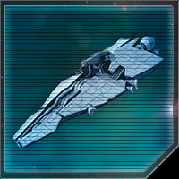
Strike-class Collective m50 Medium Cruiser
Collective Starship Analysis
Description:
The Strike cruiser serves as a second-rate ship-of-the-line with weapons focused on capital ship engagements.
Lacking in anti-Starfighter armament, this is somewhat remedied by the included squadrons of Z-95 headhunters and T-70 X-wings, although observed Collective doctrine would see the squadrons deployed in defense of capital ships rather than self-defense.
30 Dual Turbolaser Turrets
10 Ion Turrets
10 Tractor Beams
2 Squadron Hangar
Possibilities:
Z-95 headhunter
T-70 X-Wing
A/SF-01 B-Wing
Collective Quadrijet
Known Weaknesses:
Its modular design leaves sections where the modules connect exposed to well placed shots

Slide 4
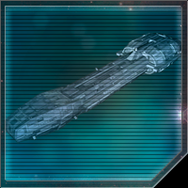
Collective Starship Analysis
Lancer-class Collective s20 Frigate
Description:
The Lancer frigate provides the main anti-Starfighter firepower for the Dreadnaught line of battle.
With 28 quad laser cannons mounted in raised pylons for increased field of fire, it poses a deadly threat to any fighters attempting to approach.
Dispersal of weapons emplacement covers the vessel from all sides, leading to a balanced, if watered down, field of fire.
28 Quad Laser Turrets
Known Weaknesses:
Lacking all other types of weaponry and reports showing no added reinforcement to the ship’s structural integrity, the frigate serves as a support ship only and cannot stand against dedicated turbo-laser fire, even from escort vessels.

Slide 5
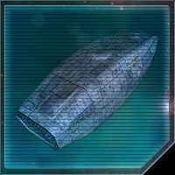
Collective Starship Analysis
Ton-Falk-Class Escort Carrier
30 Dual Turbolaser Turrets
Description:
The Ton-Falk-class Escort Carrier is a boxy 500-meter Frigate, purpose-built as a starfighter carrier.
Hyperdrive capable, this vessel has poor maneuverability and speed, with light armor and shielding.
This vessel will stay at the rear of engagements due to its limited defense, allowing the starfighters it carries to engage. Not a priority target.
10 Ion Turrets
6 Squadron Hangar
Possibilities:
Z-95 headhunter
T-70 X-Wing
A/SF-01 B-Wing
Collective Quadrijet

Slide 6
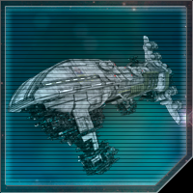
Dreadnaught-Class Collective a70 Heavy Cruiser
Collective Starship Analysis
20 Heavy Dual Turbolaser Turrets
20 Heavy Dual Turbolaser Cannons
4 Warhead Launchers
Description:
A ship of the line for the Collective, the Dreadnaught carries heavy anti-capital ship weaponry with its heavy turbo-laser armament.
Although the exact split of the ship’s weapons emplacements is not known, it is likely to follow in the vein of the original Dreadnaught design and thus it is expected that they will be spread out to cover all four sectors somewhat evenly, with a 12/10/10/8 split (fore/starboard/port/aft), with a majority of weapons better able to fire in the dorsal plane.
The ship also carries four warhead launchers, but is lacking in any dedicated anti-starfighter point defense.

Slide 7
Collective
Starship Analysis
Arcona
Starfighter Analysis
Battle Plan:
Ground Battle
Collective Starfighter Analysis
Battle Plan: Space Battle
Index
Arcona
Starship Analysis
Arcona Ground
Force Analysis
Operation Kill Mav

Slide 8
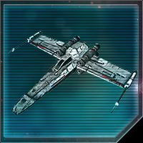
Z-95 Headhunter
Collective Starfighter Analysis
2 Laser Cannons
Description:
The Z-95 Headhunter is a 17-meter long Starfighter designed to be durable and adaptable as a multi-purpose starfighter.
This vessel is very versatile, having laser cannons, launchers and an ion cannon, and can fit into any combination of missions, despite being outdated by superior fighters.
2 Missile Launchers
1 Ion Cannon
Known Weaknesses:
It is outmatched by similar, more recent starfighters, such as the T-70 X-wing, in a one-on-one fight.

Slide 9
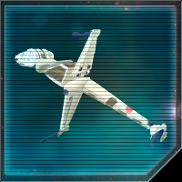
A/SF-01 B-Wing Starfighter
Collective Starfighter Analysis
Description:
The A/SF-01 B-Wing Starfighter is a 16.9-meter long Starfighter with a gyro-stabilized cockpit and s-foils designed as an assault fighter to carry heavy weapons packages with the purposes of destroying capital ships.
2 Torpedo Launchers
1 Heavy Laser Cannon
1 Dual Laser Cannon
Known Weaknesses:
It is a very slow strike craft with poor maneuverability, very vulnerable to interceptors and starfighters.
2 Ion Cannons

Slide 10
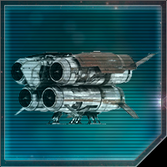
Collective Quadrijet Bomber
Collective Starfighter Analysis
Description:
The Collective Quadrijet Bomber is a
8-meter long one-time use Starfighter designed by the Collective as a modification of a transfer space tug to operate as a powerful manned bomb.
It is very fast and difficult to target properly. Upon collision, the bomber explodes for massive damage against Capital Starships.
What makes this ship dangerous is the speed with which this tiny craft can approach a capital ship and deliver a deadly payload.
Known Weaknesses:
It possesses no shields and very light armor.

Slide 11
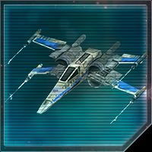
T-70 X-Wing Starfighter
Collective Starfighter Analysis
4 Laser Cannons
Description:
The T-70 X-wing Starfighter is a 12.5-meter long Starfighter with s-foils designed as a multirole starfighter, suitable for both space superiority and bombing missions.
Its outstanding speed, maneuverability and heavy armor makes it one of the best starfighters in existence to this day.
2 Torpedo Launchers
1 Blaster Cannon

Slide 12
Collective
Starship Analysis
Arcona
Starfighter Analysis
Battle Plan:
Ground Battle
Collective Starfighter Analysis
Battle Plan: Space Battle
Index
Arcona
Starship Analysis
Arcona Ground
Force Analysis
Operation Kill Mav

Slide 13
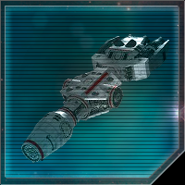
DP20 Corellian Gunship
Arcona
Starship Analysis
6 Quad Laser Turrets
Description:
The DP20 Corellian Gunship is a 120-meter long Corvette that is designed to be a fast and deadly warship.
Hyperdrive capable, this vessel has great maneuverability and exceptional speed, with average armor and shielding.
The DP20 is primarily used in anti-starfighter roles, though its dual turbolaser turrets provide for a surprising anti-capital ship bite.
4 Missile Launchers
8 Dual Turbolaser Turrets

Slide 14
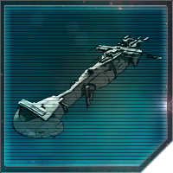
Braha’tok-Class Gunship
Arcona
Starship Analysis
8 Dual Turbolaser Turrets
Description:
The Braha'tok-class Gunship is a 90-meter long Corvette designed purely as an anti-starfighter gunship.
Hyperdrive capable, this vessel has great maneuverability and speed, with average armor and shielding. Although lacking in structural strength compared to Corvette-class ships, the Braha’tok is able to bring a substantial amount of firepower to bear for a ship its size.
8 Missile Launchers

Slide 15
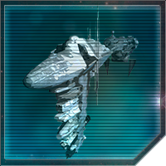
EF76 Nebulon-B Frigate
Arcona
Starship Analysis
Description:
The EF76 Nebulon-B Frigate is a 300-meter long Frigate designed as a convoy escort.
Hyperdrive capable, it has average maneuverability and speed, with average armor and light shielding.
It is an efficient vessel in its role as an anti-starfighter warship and can carry one full squadron of starfighters. It too carries a surprisingly heavy armament of 12 turbolasers for a ship its size.
12 Turbolaser Turrets
2 tractor Beams
12 Laser Turrets

Slide 16
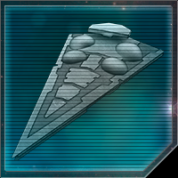
Immobilizer 418-Class heavy Cruiser
Arcona
Starship Analysis
Description:
At 600 meters long and carrying 20 quad turbolasers, the main tactical advantage that the Event Horizon affords is its four gravity-well projectors which can rip ships out of hyperspace or prevent them from escaping while within its field of influence.
Although Arconan doctrine mainly uses this capability for commerce raiding, there have been a dedicated push to expand the tactical use of pin-point gravity wells for enhanced maneuvers. The AEF has been training extensively in the use of targeted hyperspace jumps and the range of the interdiction field is well known.
20 Quad Turbolaser Turrets

Slide 17
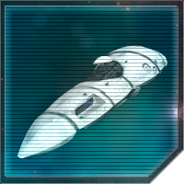
Strike-Class Medium Cruiser
Arcona
Starship Analysis
20 Turbolaser Turrets
Description:
The Strike cruiser serves as a second-rate ship-of-the-line with weapons focused on capital ship engagements. Its wide array of turrets make the ship a capable vessel against heavy opponents, but it lacks in anti-Starfighter capability.
This is somewhat remedied by the included squadrons of T-70 X-wings. Much like its Collective counterpart, the Strike cruiser’s module seams present a weakpoint that may be exploited by enemy gunners.
10 Dual Turbolaser Turrets
10 Ion Turrets
10 Tractor Beams

Slide 18
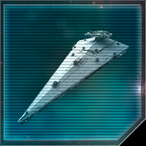
Vindicator-Class Heavy Cruiser
Arcona
Starship Analysis
25 Light Turbolaser Turrets
20 Light Quad Turbolaser Turrets
Description:
The Vindicator-class Heavy Cruiser is a 600-meter long Cruiser designed to operate independently as a multi-role cruiser.
Hyperdrive capable, this vessel has average maneuverability, speed, armor, and shielding.
It is used as a heavy attack weapon, only brought to dire situations where intense fire power capabilities are required.
20 Point-Defense Turbolaser Turrets
20 Point-Defense Ion Turrets
6 Tractor Beams

Slide 19
Collective
Starship Analysis
Arcona
Starfighter Analysis
Battle Plan:
Ground Battle
Collective Starfighter Analysis
Battle Plan: Space Battle
Index
Arcona
Starship Analysis
Arcona Ground
Force Analysis
Operation Kill Mav

Slide 20
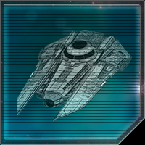
Arcona
Starfighter Analysis
VT-49 Decimator
2 Missile Launchers
Description:
The VT-49 Decimator is a 38-meter long Assault Ship that was designed by the Galactic Empire as a heavily armed Imperial Transport.
Hyperdrive capable, this vessel has great maneuverability and speed, with average armor and heavy shielding.
The squadron consists of 4 VT-49 Decimators.
2 Quad Laser Turrets

Slide 21
T-70 X-Wing Starfighter
Arcona Starfighter Analysis
4 Laser Cannons
2 Torpedo Launchers
Description:
The T-70 X-wing Starfighter is a 12.5-meter long Starfighter with s-foils designed as a multirole starfighter, suitable for both space superiority and bombing missions.
Its outstanding speed, maneuverability and heavy armor makes it one of the best starfighters in existence to this day.
1 Blaster Cannon

Slide 22
A/SF-01 B-Wing Starfighter
Arcona Starfighter Analysis
Description:
The A/SF-01 B-Wing Starfighter is a 16.9-meter long Starfighter with a gyro-stabilized cockpit and s-foils designed as an assault fighter to carry heavy weapons packages with the purposes of destroying capital ships.
2 Torpedo Launchers
1 Heavy Laser Cannon
1 Dual Laser Cannon
Known Weaknesses:
It is a very slow strike craft with poor maneuverability, very vulnerable to interceptors and starfighters.
2 Ion Cannons

Slide 23
Collective
Starship Analysis
Arcona
Starfighter Analysis
Battle Plan:
Ground Battle
Collective Starfighter Analysis
Battle Plan: Space Battle
Index
Arcona
Starship Analysis
Arcona Ground
Force Analysis
Operation Kill Mav

Slide 24
Tactical Overview
Battle Plan:
Space Battle
Collective Battlefleet Elysium assailing Shadow Academy platform Nesolat in orbit around Arx.
Hostile forces consist of a mix of heavy cruisers with supporting elements of Strike cruisers and Lancer frigates. Starfighter forces mainly T-70 X-wings and Z-95 Headhunters, with limited B-wing strike capability and a detachment of “Suicide tugs.”
Arconan Expeditionary Forces are to intercept and destroy Elysium forces, causing as much damage to the hostile fleet as possible while still preserving their own strength.
Security of the Nesolat is a limited concern. Once strike teams aboard the Nesolat have finished their missions, the security of the station is no longer vital.

Slide 25
Anticipated Hostile Action
Battle Plan:
Space Battle
Elysium is expected to assail the Nesolat with any and all means necessary, focusing on subduing the station’s defences and allowing boarding parties to land.
Since the Nesolat is only lightly defended by starfighters and relies predominantly on station defense weaponry, hostile fleet formation is presumed to be “Heavy headed”, with Dreadnaught heavy cruisers up front and Lancer frigates bringing up the rear.
Once station defenses have been sufficiently deteriorated, it is assumed Elysium will deploy its starfighter contingent to harass and further cripple the station’s turbolaser turrets.
Lancer and Strike vessels likely to remain in tactical reserve behind main force to preserve their strength, or possibly to chase down the Nesolat core if it is detached from the main station.

Slide 26
Arconan Expeditionary Forces (AEF)
Battle Plan:
Space Battle
For the purpose of this deployment, the AEF will operate in two strike groups, with vessels not mentioned held in reserve outside engagement range.
Strike Group Auresh
Event Horizon – Immobilizer 418 heavy cruiser
Unsung Valor – Braha’tok gunship
Serpent’s Strike – Braha’tok gunship
Jate’kara – Braha’tok gunship
Disquiet Balance – DP20 Gunship
Corona – DP20 Gunship
Black Hole Sun – DP20 Gunship
Rainbow Connection – Action VI Transport
VT-49 Decimator flight
Mass, & Gravity squadrons – T-70 X-wings
Strike Group Besh
Invicta II – Vindicator heavy cruiser
Eldar’s Anthem – Strike cruiser
Selen’s Song – Strike cruiser
Shadow’s Promise – Strike cruiser
Hail of Light – Nebulon-B frigate
2x VT-49 Decimator flights
Ebon, Ash, Paean, Canticle, Banshee, Siren, Bond, Oath, Defiant, & Lumen squadrons – T-70 X-wings
Slate, Onyx, & Dauntless squadrons – A/SF-01 B-wings

Slide 27
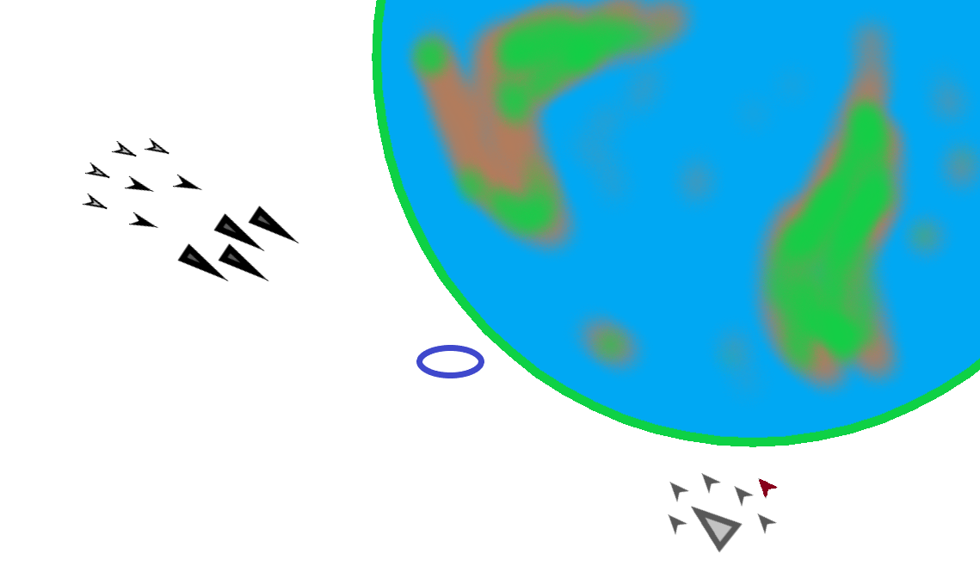
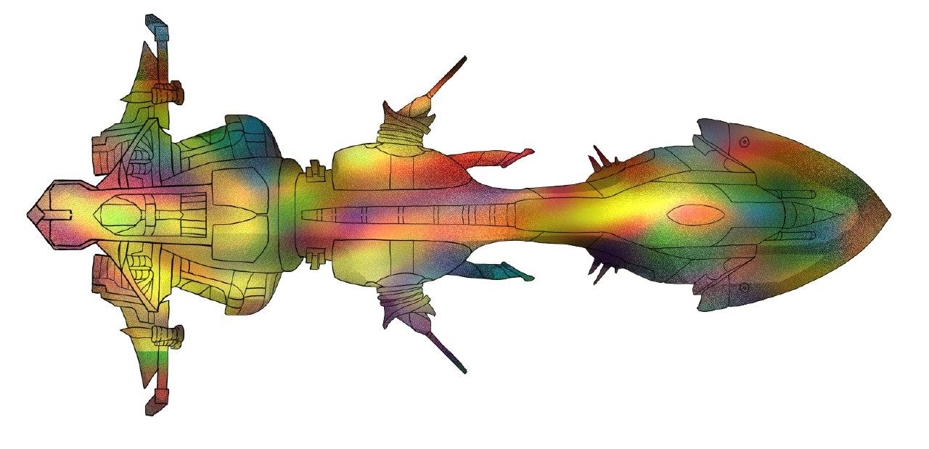
Phase 1
Battle Plan:
Space Battle
Strike Group Auresh will jump in on the opposite side of the Nesolat station, keeping the station between its ships and the Elysium forces.
Making best possible speed, Auresh is to take up positions behind the Nesolat and allow the Rainbow Connection to dock.
A Company of AEF troopers are to be set up in defense of the Nesolat and a further four lines of AV-7 anti-vehicle artillery, to be deployed on the exterior of the Nesolat for anti-starship duty.

Slide 28
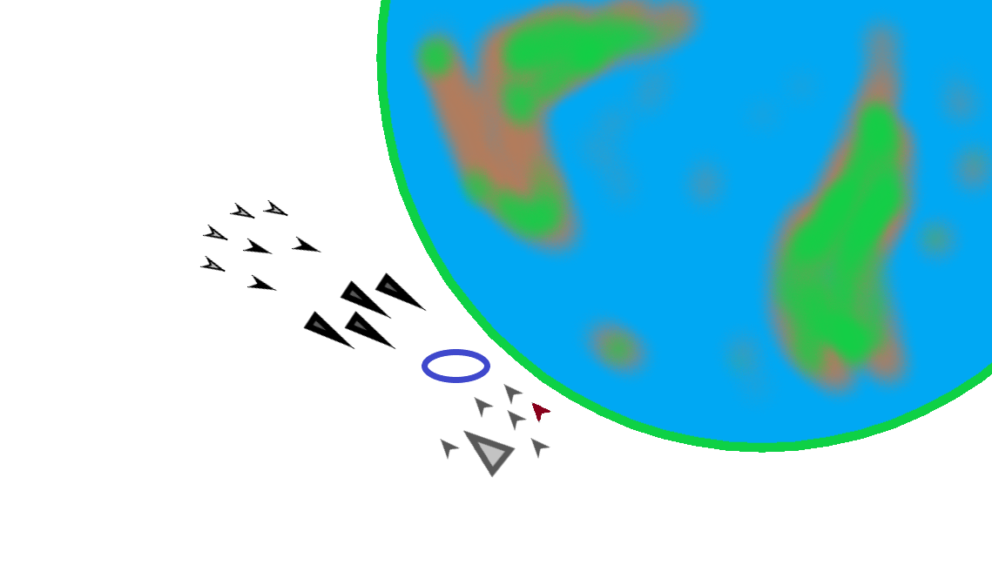
Phase 2
Battle Plan:
Space Battle
Consisting mainly of light craft, the Auresh will make use of a dispersed deployment and the greater maneuverability of the corvette craft to cover behind the Nesolat’s bulk and offer time for shields to recharge, before emerging to focus fire on Elysium warships.
Fighting is likely to be at close range once enemy reaches the station, but preservation of Auresh vessels is still a concern.
Make maximum use of cover. Shift positions between engagements. Disengage if crippled.

Slide 29
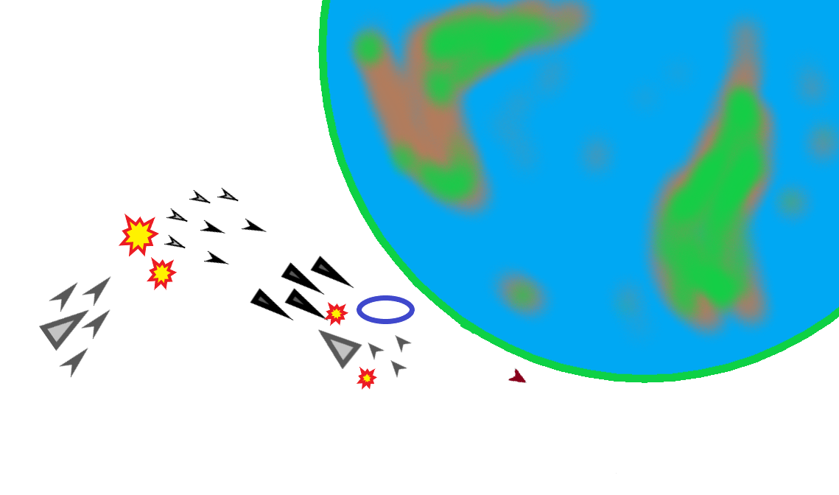
Phase 3
Battle Plan:
Space Battle
Although the battle is taking place near a planetary gravity well, Event Horizon will still deploy gravity well generators in order to provide a known and fixed jump exit point for Besh. It is presumed Elysium will still maintain its Strike and Lancer -class vessels in reserve, making them vulnerable to a sudden assault.
With Event Horizon’s known gravity well, Strike Group Besh will jump out of hyperspace behind Elysium and catch them in a pincer.
Immediate priority is the destruction of the Lancer frigates. Without their anti-starfighter firepower, Collective warships have been found vulnerable to small craft as they generally lack point defenses.
Elysium is likely to be aware of this and will seek to move Lancers in closer amongst the Dreadnaughts for protection. Focusing of maximum firepower upon the Lancers and measuredly reckless closing of the engagement range is critical to ensuring their destruction.
Use of Strike cruiser tractor beams and ion cannons highly recommended.

Slide 30
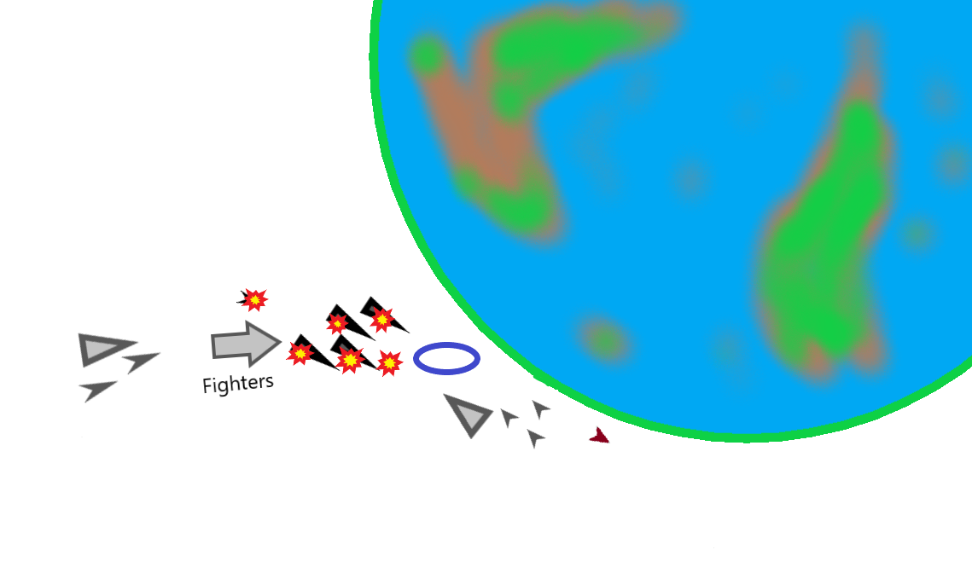
Phase 4
Battle Plan:
Space Battle
Upon the destruction of the Lancer frigates, main bulk of AEF starfighters are free to engage main Elysium forces.
Having been engaged for longer, and without sufficient anti-starfighter fire support from their capital ships, Elysium starfighter screen can be overwhelmed by Besh starfighter forces.
Once Elysium’s fighter protection has been sufficiently eroded, X and B-wing strikes should prioritize crippling the engine sections of targeted Dreadnaughts first, limiting their ability to disengage.
Elements of Besh and Auresh are free to engage if they can do so without needlessly exposing their ships to enemy fire.

Slide 31
Battle Plan:
Space Battle
Contingencies
Although the Dajorran Intelligence Agency is certain that Elysium will behave in the manner described above, there exists a possibility the enemy may choose to respond or operate in different manners. These are listed below.
Contingency Scenario 1:
Hostile Deployment
Contingency Scenario 2:
Committed Reserves
Contingency Scenario 3:
Suicide Tugs
Contingency Scenario X:
Iron Legion Betrayal

Slide 32
Battle Plan:
Space Battle
Contingency Scenario 1: Hostile Deployment
It is considered unlikely, but not impossible, that the enemy will seek to utilize their own starfighter screen in a more aggressive manner to target the Nesolat.
In such a case, Auresh should seek to draw the fighter screen further away from the Nesolat, using Rainbow Connection as bait, if need be.
The goal is the destruction of as many starfighters as possible, as the weakening of the enemy’s anti-starfighter protections is key to ensure AEF victory.
Although the Nesolat will likely suffer more damage if this approach is taken, it is considered acceptable and the plan will proceed otherwise as before.

Slide 33
Battle Plan:
Space Battle
Contingency Scenario 2: Committed Reserves
Although sound tactical reasoning would dictate Elysium to hold back its more vulnerable craft from direct engagement, it is not inconceivable that the Lancers will be kept closer to the main force during the enemy’s assault phase.
If so, the formation they are likely to adopt will seek to screen the Lancers from the front as well as sides as the Nesolat has fairly wide firing arcs due to its shape.
The crescent formation of Elysium Dreadnaughts will be difficult to penetrate, but a decisive strike by Auresh corvettes from below the plane of engagement should yield positive results.
The Dreadnaught has fewer turbolasers in its ventral section and thus is less well equipped to defend against attacks from this vector. Further, if it wishes to bring more weapons to bear, it will inevitably be exposing the more vulnerable section of its hull to the Nesolat’s guns.
It is likely that the corvette force will suffer some casualties, but if such an action is necessary, it must be committed to with unyielding determination and the crews instructed to bring down the Lancers by any means necessary.

Slide 34
Battle Plan:
Space Battle
Contingency Scenario 3: Suicide Tugs
The time and place of the enemy’s use of its Suicide Tugs is unknown, however, a few basic options present themselves.
Disruption of the Nesolat – The use of Suicide Tugs against large, well armored Brotherhood units is well documented, and thus it is highly likely they will be deployed in some manner during the opening moments of the battle in order to cripple the Nesolat. Their destruction would leave more guns for Elysium to contend with, and thus it is advised to prioritize them during the opening parts of the engagement. It is unlikely that they would target the main reactor, or the administrative module, but rather locations of turbolaser batteries or shield generator banks. Sensor operators are to be on high alert during this phase and report any suspicious movement by small craft.
Attack the Event Horizon – As above, the Event Horizon presents a tempting target for Elysium forces and a
prime opportunity for its suicide tugs. To that end, it is recommended to keep the Event Horizon further back
where it may enjoy use of its quad turbolasers at range, and be protected by layered defenses of the Nesolat
and interceding corvettes. However, when Besh is to be deployed, the Event Horizon will be forced to expose itself for a limited period of time, thus presenting a tempting target for the suicide tugs. To deter this, both X-wing squadrons are to be
kept in reserve for the purpose of providing a starfighter screen during this critical moment. Use of X-wings for
any other task is highly discouraged.
Counterattack of Besh – Once the Lancers come under attack, it is possible the enemy will seek to disrupt the Strike Group by throwing the suicide tugs into their midst and buying time for the Lancers to escape. If this is the case, Hail of Light is to be deployed forward in intercept. Either the tugs will take the bait and destroy only a single ship, or they will have to pass through the Nebulon-B’s proximity and weather its full anti-starfighter firepower. Either option is likely to lead to the tugs’ destruction. Main force of Besh should be proceeding as per main plan.

Slide 35
Battle Plan:
Space Battle
Contingency Scenario X: Iron Legion Betrayal
Although ostensibly sharing a common enemy in the Collective, it would be unwise for any fleet commander to fully assume there to be no danger of subterfuge by Iron Legion forces.
As such, pre-prepared jump coordinates are to be kept calculated at all times in order to conduct a swift retreat were any sort of trap to be sprung.
Where such a move is to be found impossible, Auresh and Besh are to combine forces around whichever strike group is lesser engaged, or further away from Arx if equally engaged, and fight their way towards the system’s edge.
If breaking out is unlikely, fleet commander is to order emergency codes be broadcast and the fleet dispersed, with each vessel seeking to escape however their captains see fit, and regroup in Dajorra.
If any escape is deemed impossible and destruction of AEF fleet effectively certain, remaining vessels are to be used with speed and ruthlessness to ensure maximal damage to Iron Legion forces. Losses inflicted here may be the difference between Dajorra surviving or not.

Slide 36
Collective
Starship Analysis
Arcona
Starfighter Analysis
Battle Plan:
Ground Battle
Collective Starfighter Analysis
Battle Plan: Space Battle
Index
Arcona
Starship Analysis
Arcona Ground
Force Analysis
Operation Kill Mav

Slide 37
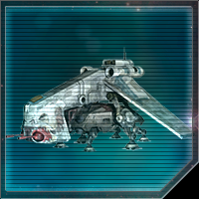
Low Altitude Assault Transport/carrier (LAAT/c)
Arcona Ground
Force Analysis
Description:
The Low Altitude Assault Transport/carrier (LAAT/c) Platoon is a ground armor deployment unit that consists of eight LAAT/c, along with eight pilots, eight technicians, and four mechanics to operate and maintain them.
Designed to operate as a low-altitude gunship that carries and deploys a range of ground armor using powerful magnetic clamps while the pilot can also operate a pair of front mounted light laser cannons.
Operated by the pilots in the platoon, they cannot carry passengers.

Slide 38
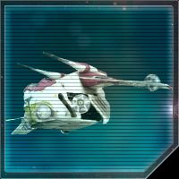
Low Altitude Assault Transport/infantry (LAAT/i)
Arcona Ground
Force Analysis
Description:
The Low Altitude Assault Transport/infantry (LAAT/i) is a troop transport unit that consists of eight LAAT/i, along with relevant pilot and service personnel.
Designed for aerial-based support and troop transport, it is heavily armored with drooping wings and sliding doors to protect its passengers, with a pair of anti-personnel laser turrets on the front and one covering the stern, along with two pinpoint laser turrets mounted on the wings and two composite beam laser turrets that deploy from the sides with their own gunners in its standard configuration.
Operated by the pilots and gunners in the platoon, each can carry 30 passengers allowing the platoon to carry 240 soldiers or passengers.

Slide 39
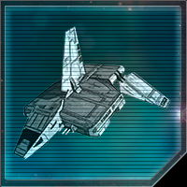
Sentinel-Class Landing Craft Flight
Arcona Ground
Force Analysis
Description:
The Sentinel-class Landing Craft is a 38-meter long troop transport unit that consists of four Sentinel-class Landing Craft, along with four pilots, four copilots, twelve gunners, four technicians, and two mechanics to operate and maintain them.
Designed as a multipurpose drop ship for transporting troops and armor directly into battle safely, it is heavily armed with eight retractable laser cannons, two retractable repeating blaster cannon turrets, one retractable ion cannon turret and two missile launchers.
Hyperdrive capable, this vessel has great maneuverability and speed, with heavy armor and shielding. Operated by the pilots in the flight, each can carry up to 75 stormtroopers, allowing the flight to carry 300 soldiers or passengers or with alternate configurations depending on the nature of the mission a range of different armor or support vehicles.

Slide 40
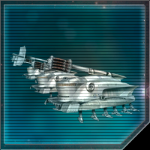
Self-Propelled Heavy Artillery (SPHA) Line
Arcona Ground
Force Analysis
Description:
The Self-Propelled Heavy Artillery Line (SPHA) is a collection of eight pieces of Self-Propelled Heavy Artillery.
Only able to deployed by larger transports, these massive pieces of equipment slowly move using twelve legs and have a heavy turbolaser cannon with tremendous range mounted to it capable of extreme direct fire damage to slower moving targets that could penetrate deflector shields.
Each piece of artillery can carry thirty soldiers for defensive support, and each of the twelve legs contains a retractable anti-personnel blaster.

Slide 41
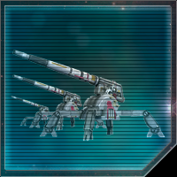
AV-7 Anti-Vehicle Artillery Cannon Line
Arcona Ground
Force Analysis
Description:
The AV-7 Anti-vehicle Artillery Cannon Line is a collection of eight AV-7 Anti-vehicle Artillery Cannons.
Each cannon can be moved using built in repulsorlifts, and when in position is entrenched using four metallic feet for support.
These represent a reliable and heavy counter to enemy armor and heavier cyborg units.

Slide 42
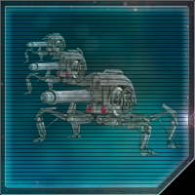
JP-1 Proton Cannon Artillery Line
Arcona Ground
Force Analysis
Description:
The J-1 Proton Cannon Artillery Line is a collection of eight pieces of J-1 Proto Cannon Artillery.
Each cannon uses its four metallic legs for transportation and can also be used to entrench it into position when ready to fire.
These represent a reliable and heavy counter to enemy armor and heavier cyborg units.

Slide 43
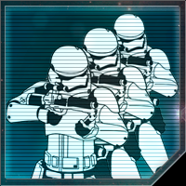
Line Company
Arcona Ground
Force Analysis
Description:
The Line Company is a company strength unit with basic command and support personnel elements, droids and equipment.
The company has 152 soldiers equipped with BlasTech E-11 blaster rifles.
Compared to its Elysium opponents, the standard Line Company lacks specialization in training and equipment.
However, it still outclasses militarily the enemy Fanatics. Best used in a medium-to-short range engagement from prepared positions.

Slide 44
Collective
Starship Analysis
Arcona
Starfighter Analysis
Battle Plan:
Ground Battle
Collective Starfighter Analysis
Battle Plan: Space Battle
Index
Arcona
Starship Analysis
Arcona Ground
Force Analysis
Operation Kill Mav

Slide 45
Tactical Overview
Battle Plan:
Ground Battle
After breaching the planetary shield around Arx, Collective forces have deployed air support assets that are targeting Iron Legion and other Brotherhood units in the area South of the Iron Legion headquarters.
Initial recon shows the hostile air forces consisting mainly of Z-95 Headhunters, B-Wings, and T-70 X-Wings, as well as lesser amounts of Suicide Tugs.
Further, up to eight Lancer frigates have breached the atmosphere and are moving towards the operational area.
In total, we are placing 36 Collective fighter squadrons of varying types within the operational area, supported by the Lancers.
Arconan Expeditionary Forces are to deploy planetary assets within the operational area South of the Iron Legion HQ to contest and deny enemy air superiority. Destruction of all hostile air assets is not required, but operational freedom of Iron Legion and Brotherhood forces must be guaranteed.

Slide 46
Anticipated Hostile Action
Battle Plan:
Ground Battle
The DIA analysis predicts Collective forces to be operating in strike groups centered around a pair of Lancers for four strike groups in total.
Z-95 squadrons are likely to be used in conjunction with Suicide tugs to scout out air defenses and engage or suppress them. X-wing and B-wing units will be deployed against hard targets, installations, and battlefield fortifications where their greater firepower can be used to full effect.
Lancer frigates lack the direct firepower to be used effectively in air-to-ground operations, but pose a distinct danger to Iron Legion and Brotherhood air assets, thus forming a protective umbrella of area denial and allowing Collective squadrons to operate with impunity.
The four independent strike groups are predicted to operate in advance of, and in conjunction with, Collective ground troops as they make their attacks on the Iron Legion Headquarters.

Slide 47
Arconan Expeditionary Forces (AEF)
Battle Plan:
Ground Battle
Having stayed in reserve, the Will of our Lady remains undamaged and ready to deploy AEF ground assets to the battlefield. The following detachments are being deployed to the operational area:
10x LAAT/i Platoon (80 hulls in total)
5x LAAT/c Platoon (40 hulls in total)
4x Sentinel landing craft Flight (16 hulls in total)
AEF 3rd and 4th Regiment (4 Battalions)
24x Line Company (3648 Troops)
4x SPHA Line (32 pieces)
10x AV-7 Anti-vehicle Artillery Line (80 pieces)*
14x JP-1 Proton Cannon Artillery Line (112 pieces)
*: 4 Lines of AV-7s lost during Space Battle

Slide 48
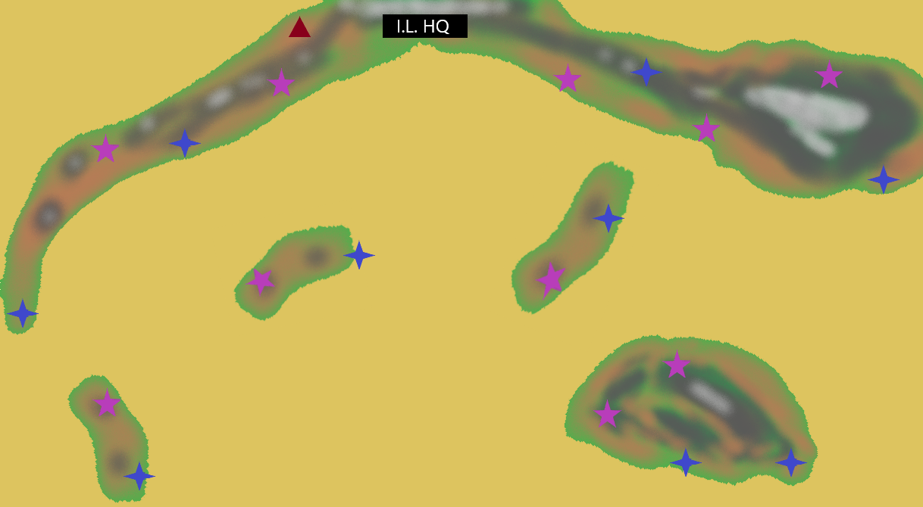
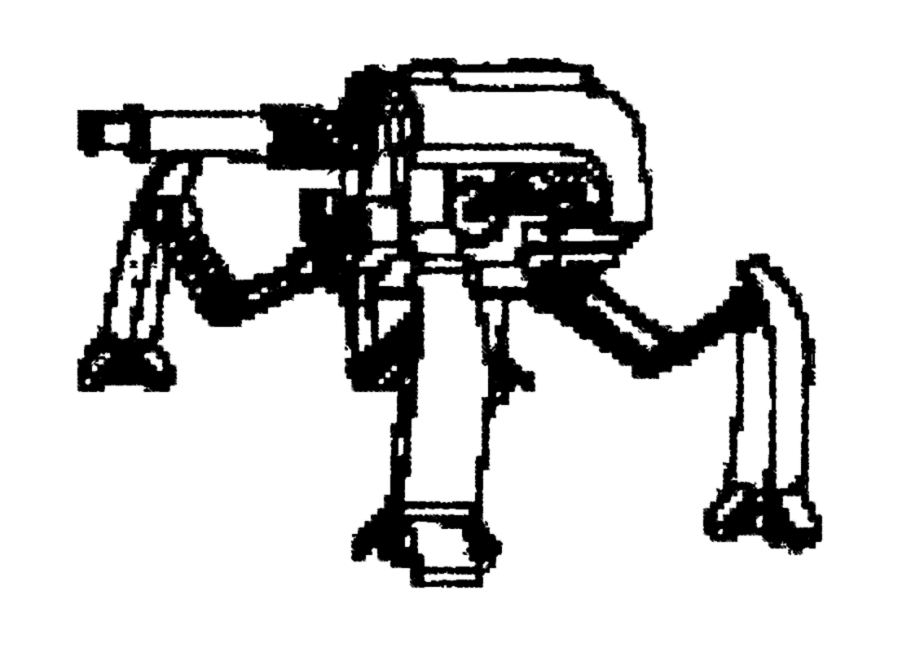
Phase 1
Battle Plan:
Ground Battle
AEF troops are to deploy via LAAT to the strategically important locations shown in the attached map. Sentinel landers are to be used for moving of heavier equipment while LAAT/c can more quickly deploy pairs of artillery pieces into hard-to-reach areas. Heavy concealment is to be observed and where possible, neighboring pairs of artillery lines be connected via communication cables to ensure safety of communication.
The basic deployment of artillery units is to follow standard AEF protocol, with individual guns having pre-prepared secondary positions, as well as pre-scouted tertiary firing positions.
Individual from Line Companies are to be deployed via LAAT to less optimal positions to erect false emplacements. Sloppy camouflage and sub-par concealment of gun tracks is encouraged.
SPHA unit commanders are to scout out suitable firing positions for their units along venues of potential attack, meaning behind deployment zones of Brotherhood ground troops and/or major field fortifications.

Slide 49
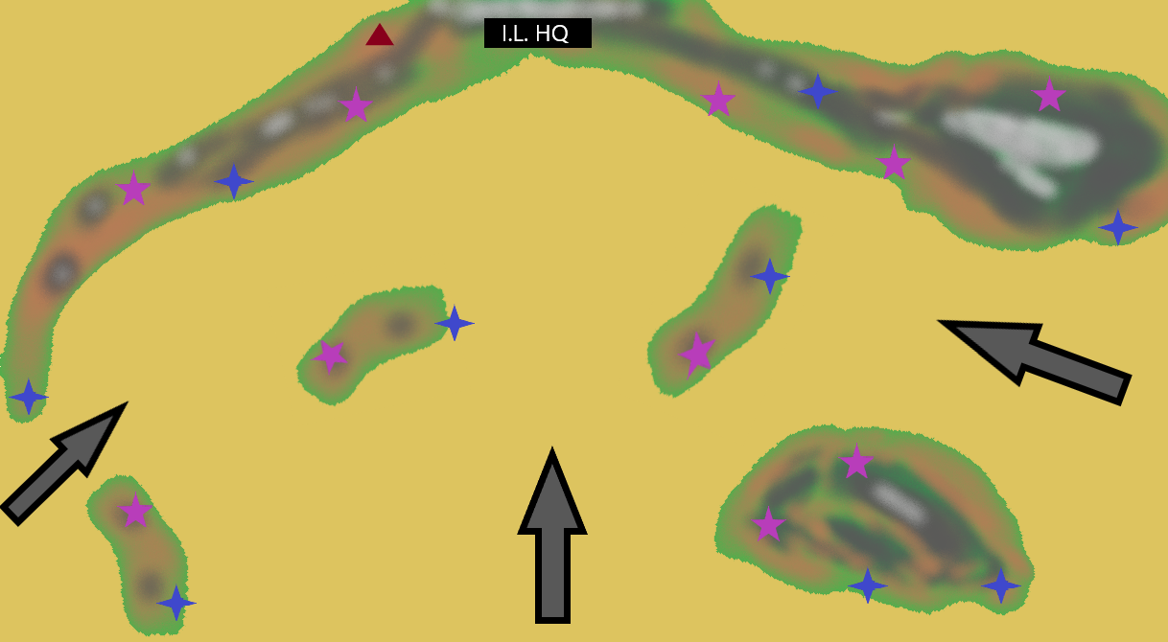
Phase 2
Battle Plan:
Ground Battle
Line Companies re-deployed to provide close support for the artillery batteries against airborne attacks.
JP-1 units deployed in heavily concealed and kept in main firing positions. AV-7 units in main firing positions and ready to engage. SPHA units mounted in transports and ready to be deployed to pre-scouted firing positions.
LAATs rearmed with air-to-air weaponry where possible. All units prepared for engagement.

Slide 50
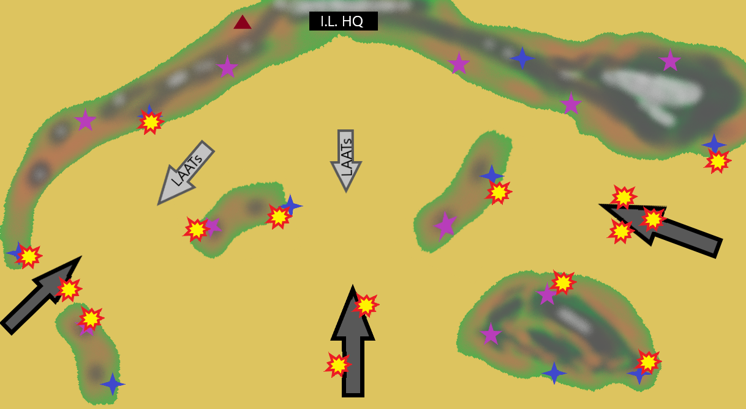
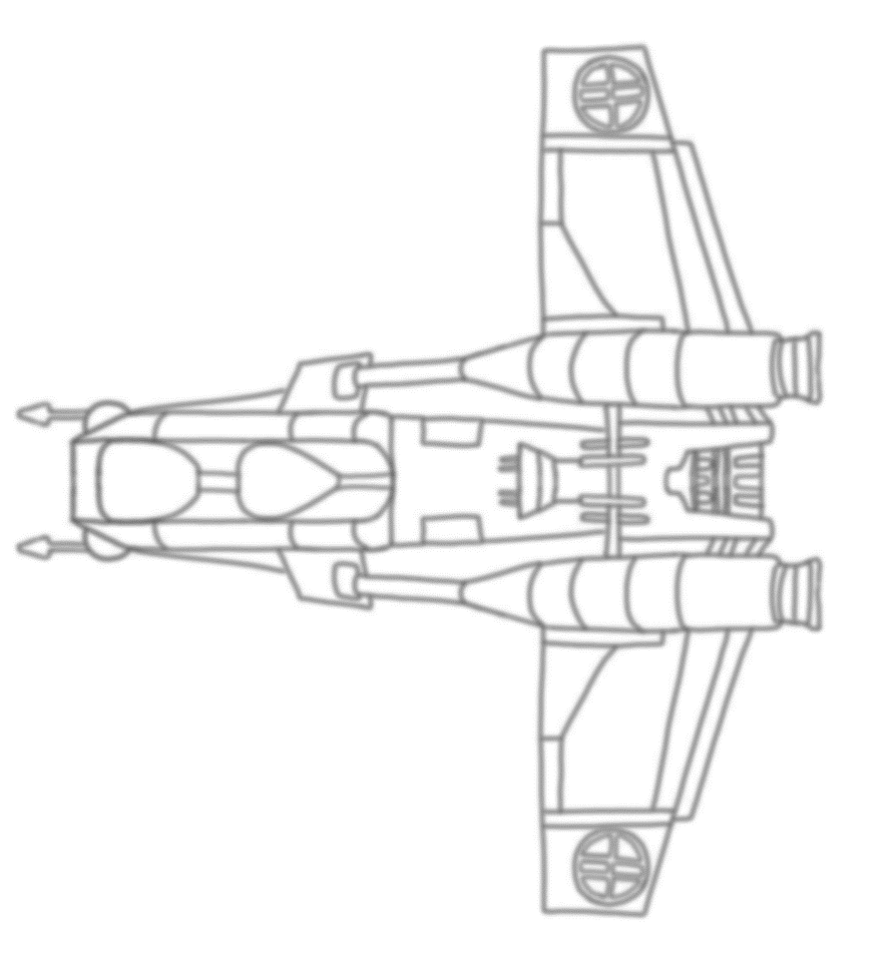
Phase 3
Battle Plan:
Ground Battle
Initial air to air fight to be born by second line AV-7 and LAAT units, most likely against Z-95s and suicide tugs. Proper dispersal of guns should limit losses if suicide tugs were to be successful in breaching the perimeter. At any one time, only max 20% of available batteries to engage targets.
LAATs to be prioritize homing weaponry for engaging Z-95s due to the starfighters’ greater maneuverability and higher speed. Engaging in dogfights inadvisable. Preservation of own strength while depleting the enemy’s fighter screen is paramount.
Enemy likely to engage false positions as targets of opportunity, Z-95s will provide a superior target for AV-7 fire after completing a strafing run. Engaging enemy fighters when breaking off from their attack runs by enfilading fire from two batteries with overlapping fire likely to result in favorable casualty exchange.

Slide 51
Phase 4
Battle Plan:
Ground Battle
Once the enemy forward air elements have been sufficiently weakened and the main battle is engaged, Lancer frigates and escorting heavier strike groups likely to appear. In order to ensure swift and decisive destruction of hostile air elements, JP-1s are advised to open with a simultaneous medium-range barrage using a minimum of two, but preferably three, lines per squadron.
Upon destruction of target squadron(s), battery are to be moved to alternate firing positions in order to avoid counter-battery fire or aerial attack.
JP-1s are also capable of destroying Lancer frigates, which should be seen as secondary targets as they cannot cause as much damage to ground troops as the X-wing and B-wing squadrons.
SPHAs are to be deployed as per battlefield command to pre-scouted firing positions from which they may engage Lancer frigates swiftly and decisively. Utilization of a full line of eight vehicles against a single Lancer very likely to yield favorable results with one or two salvos. The Lancer is not designed to withstand such heavy firepower, especially in an atmosphere where their shields will be less effective.
Upon destruction of a Lancer, SPHAs are to be reimbarked and ferried away firing position in order to avoid counter-battery fire or aerial attack.

Slide 52
Contingencies
Battle Plan:
Ground Battle
Although the Dajorran Intelligence Agency is certain that Collective air units will behave in the manner described above, there exists a possibility the enemy may choose to respond or operate in different manners. These are listed below.
Contingency Scenario 1:
Swarm Tactics
Contingency Scenario 1:
Airborne Assault
Contingency Scenario X:
Iron Legion Betrayal

Slide 53
Contingency Scenario 1: Swarm tactics
Battle Plan:
Ground Battle
It is possible, though unlikely, that the Collective will eschew the protection or air support along their entire front and will instead focus the majority of their units in a ‘swarm’ along a single sector in hopes of overwhelming it.
Were this to happen, LAAT gunships are to be redirected to aggressively attack Collective ground troops and to stall their advance in other sectors. Artillery lines, where feasible, are to be deployed/redirected to face the enemy swarm and open fire with up to 70% of available units, if possible. SPHA units to remain in reserve until they can be deployed more safely to engage grouped-up Lancers.
The goal is to make the Collective pay for their lack of air superiority in other sectors, relieving pressure on Brotherhood frontline units that may be then used to reinforce the main sector of the enemy’s advance. Further, such a high concentration of enemy air power in one place will congest the skies and allow a sudden and overwhelming use of anti-air artillery to disrupt their formations.
Once sufficiently disrupted, it is likely the Lancers will be left unguarded, being far slower than the starfighters escorting them. If a window of opportunity presents itself, SPHA units are to be deployed aggressively, possibly straight into firing position, and engage Lancers. Due to the clumped up nature of these large airborne targets, a dispersed crescent-shaped deployment of SPHA lines along a wide area will likely yield favorable results in providing crippling fire to the formation and disallowing an orderly retreat.

Slide 54
Contingency Scenario 2: Airborne Assault
Battle Plan:
Ground Battle
Although not mentioned, it is possible the Collective might try deploying troops from the Lancers in order to attack anti-air batteries. Jet pack armed cyborg infantry is not an unknown quantity among their ranks.
To counteract this, each artillery battery will have half a Company of Line Infantry as close support, and the paired battery have precise coordinates to the location of allied units in order to ensure accurate fire support ‘danger close’ if such be required. If contact to any battery be lost, the paired battery (if not engaged) is to conduct an area fire mission to destroy surviving hostile troops.
Where further reinforcement is required to deal with ground troops, a special detachment consisting of a flight of VT-49 Decimators, two Special Missions Companies from the 2nd Regiment 4th Battalion and two Assault Companies from 2nd Regiment 2nd Battalion will be made available to the battlefield commander. These forces are held in strategic reserve, however, and are not listed in the main forces available as they are meant solely for counter-attack purposes.

Slide 55
Contingency Scenario X: Iron Legion Betrayal
Battle Plan:
Ground Battle
While deployed upon Arx and operating in close proximity to Iron Legion forces, AEF units are especially vulnerable to sudden disloyalty by Legion units. As per AEF rules of engagement, we are not to fire first, but we will fire last. The Will of our Lady will be kept in reserve and further extraction of deployed AEF units will be maintained as a possibility.
In the event of treason, artillery batteries are to be turned upon key Iron Legion structures as identified by deployed Scout units from 2nd Regiment. Further, forces from 2nd Regiment will be prepared to conduct a counterattack and cause further confusion and chaos in order to buy 4th Regiment time to withdraw. Where units are unable to withdraw via LAAT or Sentinel, artillery pieces are to be destroyed and ammunition dumps detonated before proceeding on foot to designated extraction points.
If any escape off world is deemed unlikely or impossible, surviving AEF forces are to engage in sabotage and partisan warfare for as long as they are able to. Losses inflicted, and forces tied up in defense of Arx installations may be the difference between Dajorra surviving or not.

Slide 56
Collective
Starship Analysis
Arcona
Starfighter Analysis
Battle Plan:
Ground Battle
Collective Starfighter Analysis
Battle Plan: Space Battle
Index
Arcona
Starship Analysis
Arcona Ground
Force Analysis
Operation Kill Mav

Slide 57
Operation:
Kill Mav
Error 436: Insufficient Clearance
> Higher level clearance required……………………
> ……………………………………………………………………………………
> Session Terminated………………………………………………
> ……………………………………………………………………………………
> Security measures………………………………….
> ……………………………Deployed………………………………
> ……………………………………………………………………………………
> ……………………………………………………………………………………
…………Nice try Schuttas!..................................................
> ……………………………………………………………………………………
> .......................................ARCONA_INVICTA!......................

Slide 58
Force Projection Plan: Evant-Horizon
Clan Arcona
Highly Classified

Slide 59
Participants:
Tali Sroka (PN: 14782)
Texts and Strategy
Tybalt Ma'jahirr Rawioni (PN: 15010)
Ship asset coloring
Diyrian Grivna (PN: 14615)
Ship asset lineart
Aru Law (PN: 15665)
- Compilation and slide backgrounds

